Slide 1
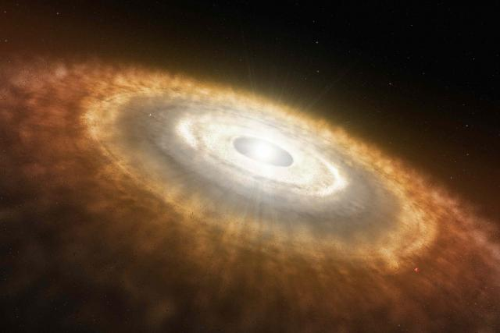
Protoplanetary Disks and Giant Planet Formation

Slide 2
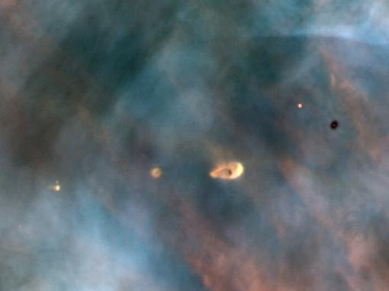
As Seen by Hubble, in the Orion Nebula

Slide 3
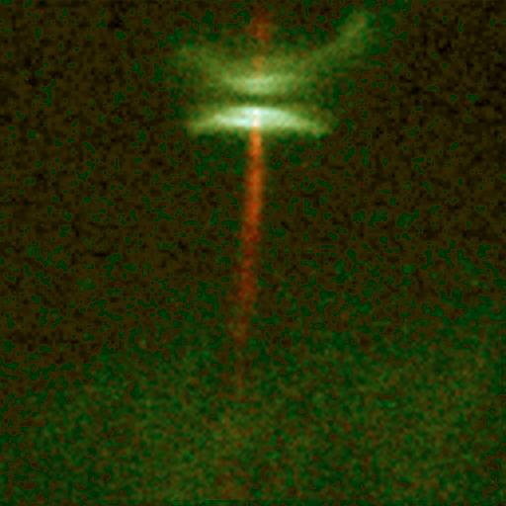

Slide 4
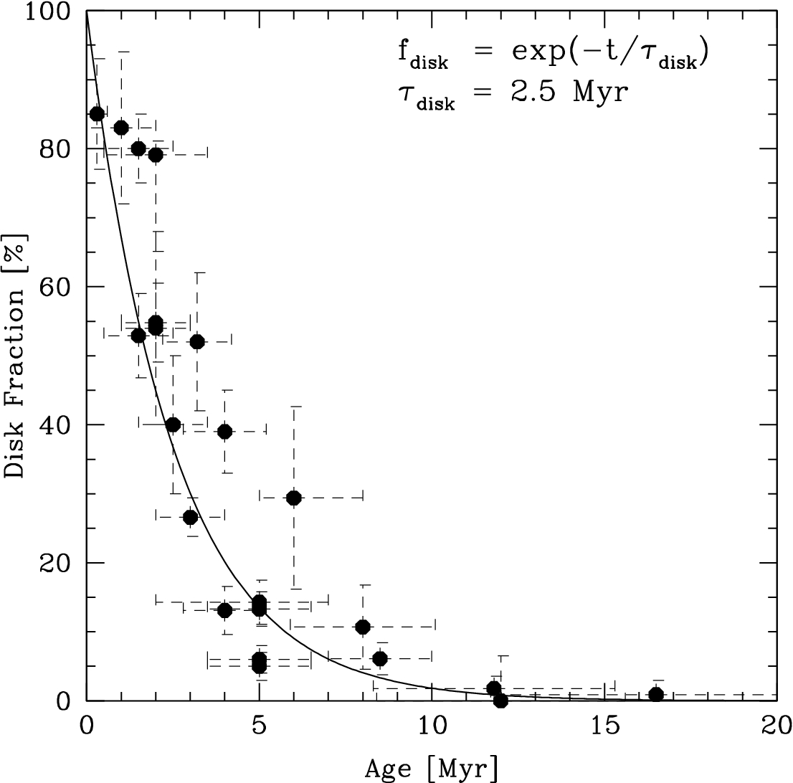
Disks have a very limited lifetime, basically ~3 Myr
Giant planet formation must be very fast, because giant planets must accumulate tens to hundreds of Earth masses of nebular gas, before it is lost

Slide 5
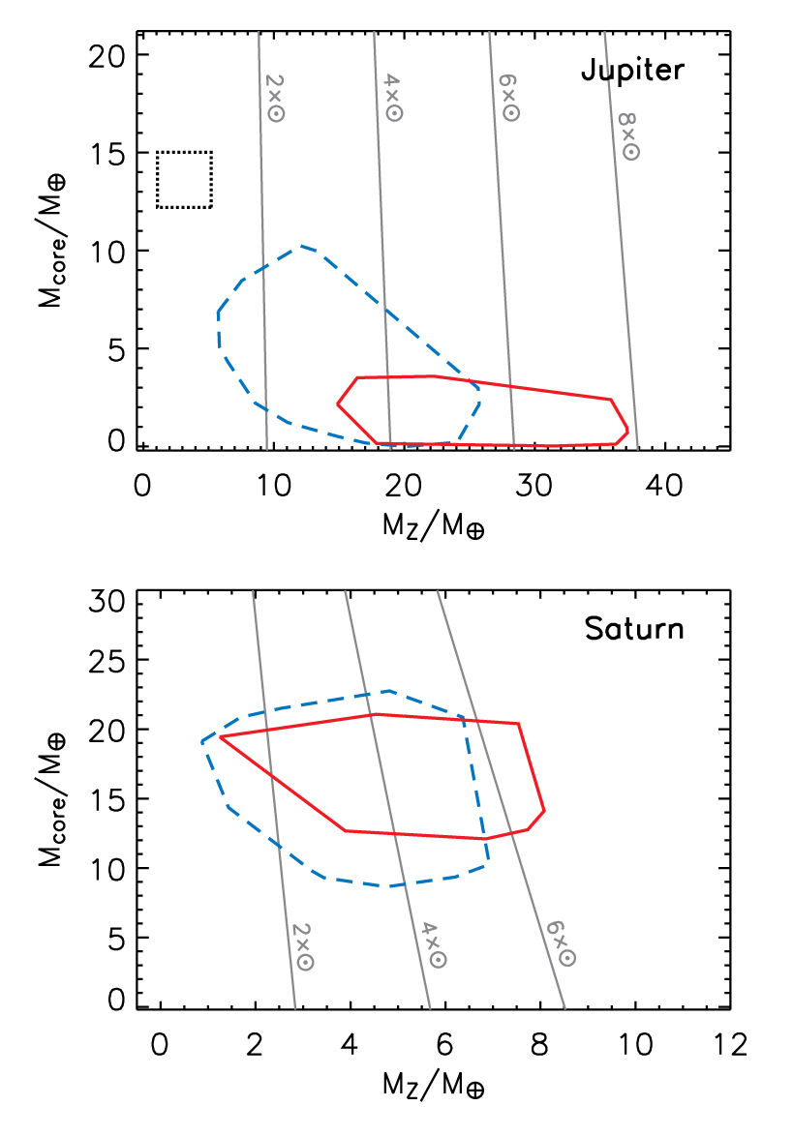
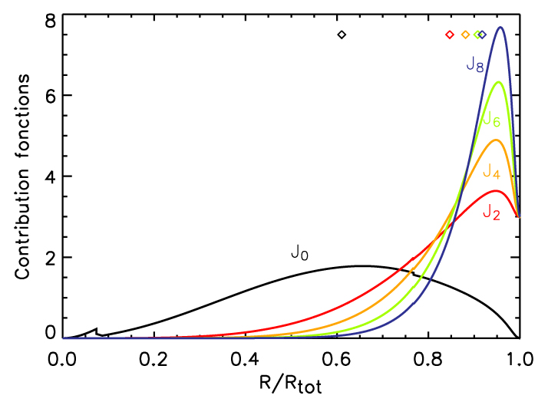
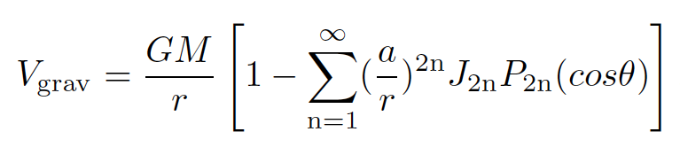
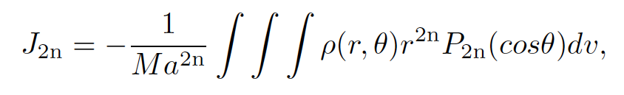
Jupiter and Saturn:
Current Interior

Slide 6
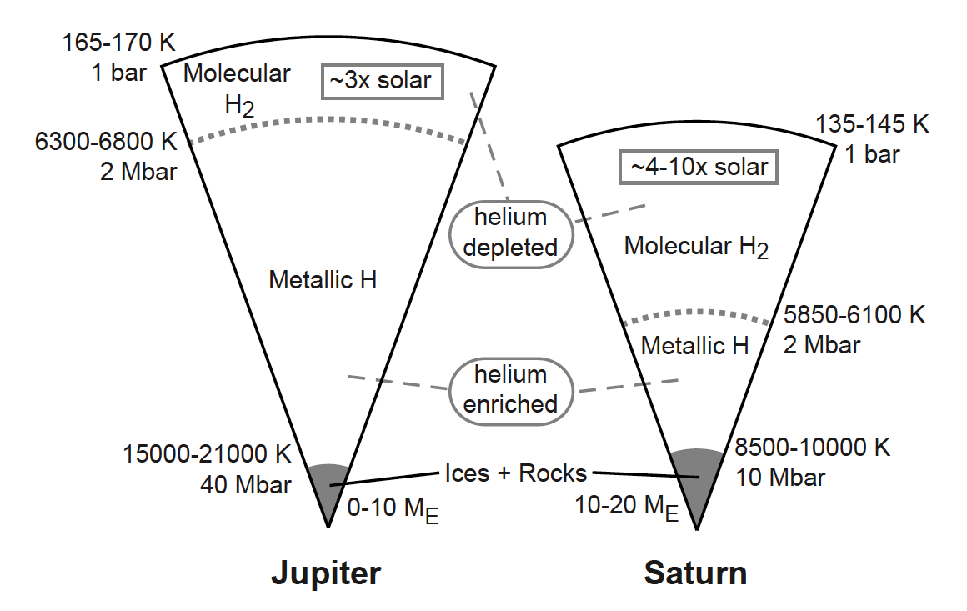
Schematic View of Jupiter and Saturn
Fortney, Baraffe, & Militzer (2010)

Slide 7
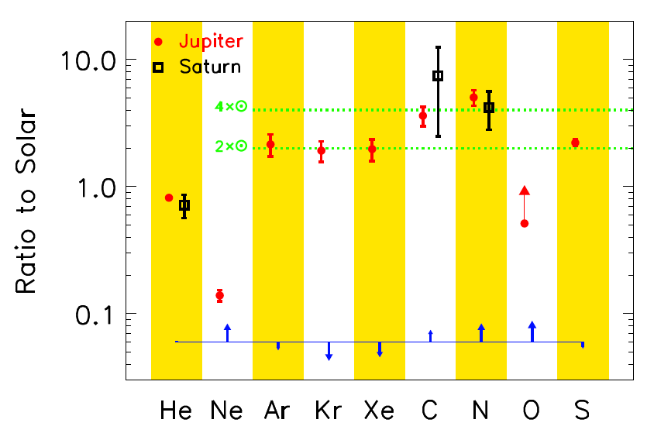
Envelope Abundances for Jupiter and Saturn
“Solar” is Lodders (2003)

Slide 8
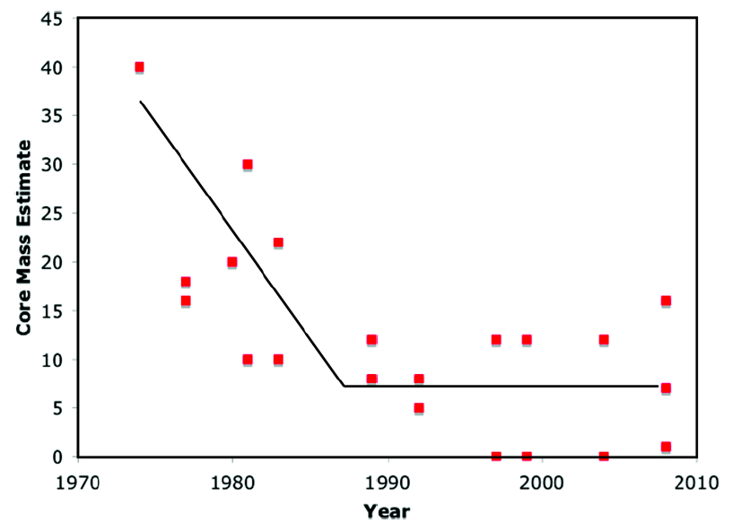
Evolution of Calculations of Jupiter’s Core Mass
Improving EOSs, calculated by many groups
SCVH EOS only
First
principles
Fortney & Nettelmann (2010)

Slide 9
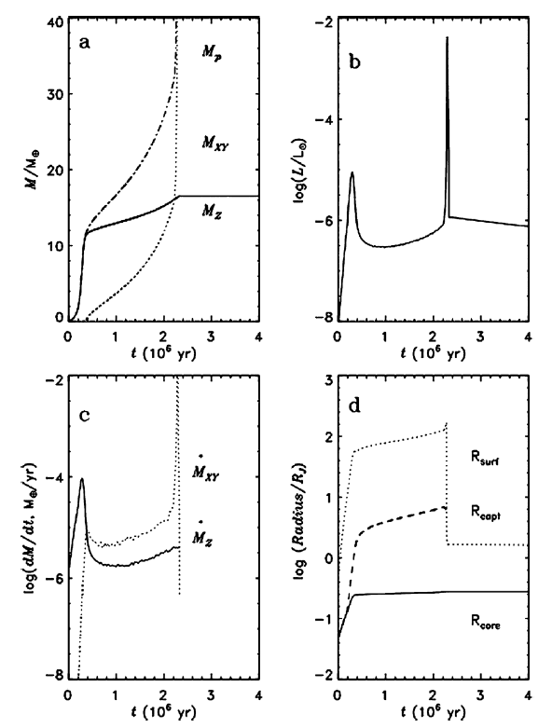
Modeling Core-Nucleated Accretion

Slide 10
Standard Problems with Core Accretion Scenario
  Can you for a 10 M_Earth core in ~ 1 Myr
  Yes, if at the snow line
Can the core accrete 1 MJ of gas before the gas disk goes away?
  Yes, if Cores migrate in the disk to find new gas
  Yes, if the opacity in the proto-envelope is low enough to let the proto-envelope cool and contract quickly
What if Jupiter doesn’t have a core?
  Core can be dissolved and redistributed within the planet

Slide 11
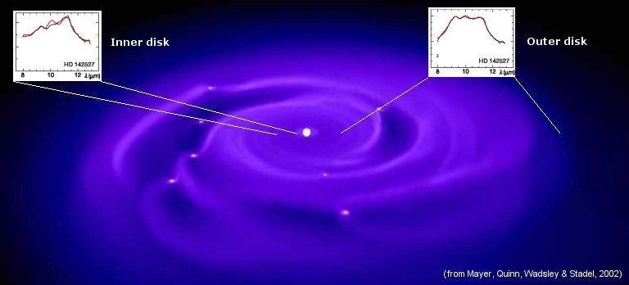

Slide 12
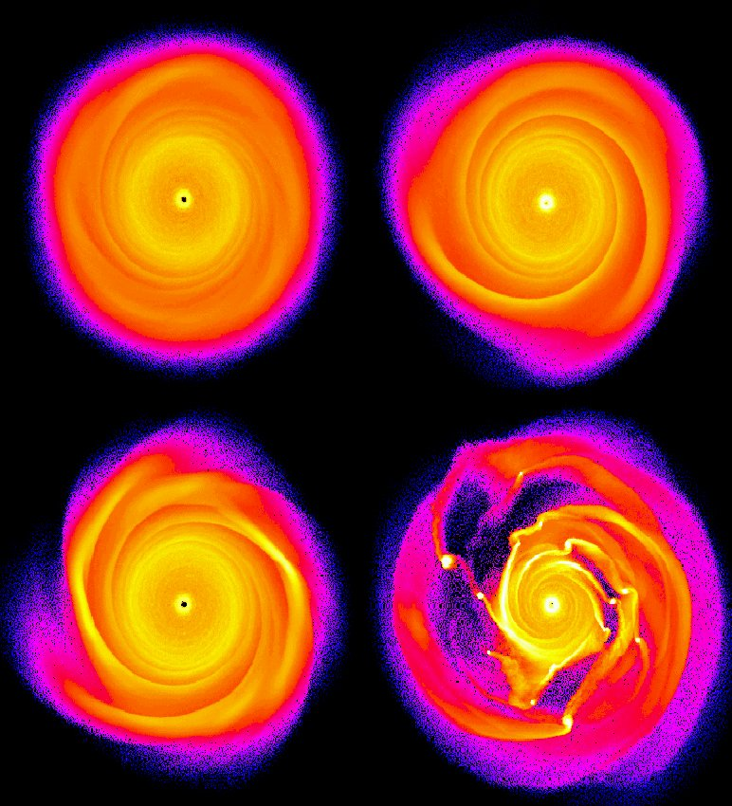

Slide 13
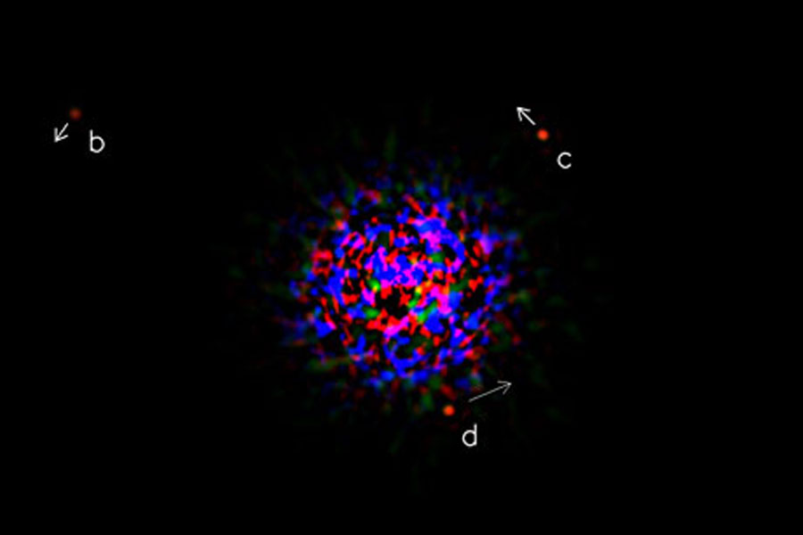
HR 8799 Planetary System: b, c, d, e

