Slide 1


CANDELS: A Cosmic Quest for Distant Galaxies Offering Live Views of Galaxy Evolution
David Koo
UC Santa Cruz
&
CANDELS Team
AAS Meeting
June 7, 2017
Notes:
Thank you James for your overly generous introduction. And thank you for this opportunity to share what I think is the go-to survey for anyone not already seduced by exo-planets and still interested in distant galaxies and AGNs. First things first – CANDELS is not a misspelling! This was to enable astronomers to find our survey rather than 3 million other sites selling candles or talking about standard candles.

Slide 2
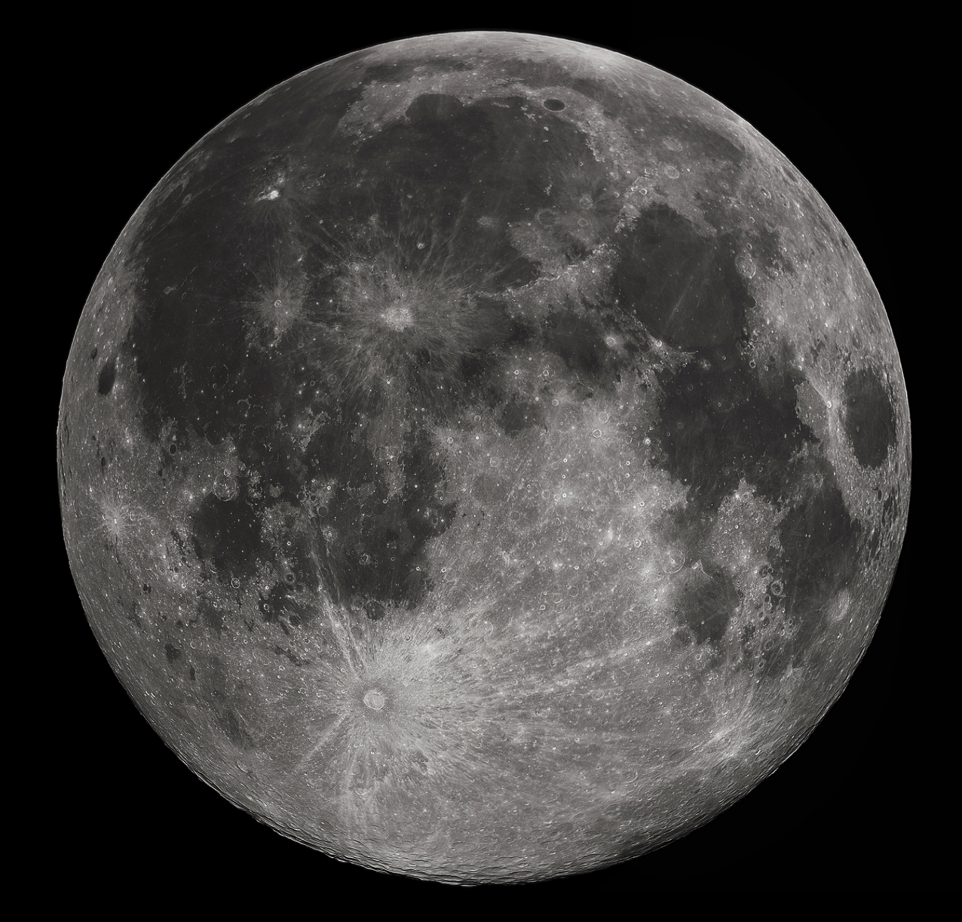
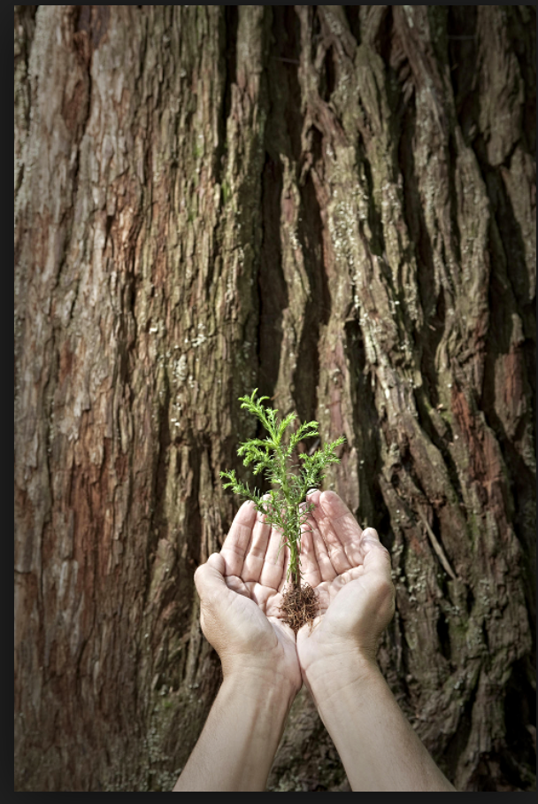
Mighty redwoods from little seedlings grow
Hubble Deep
Field (1995)

Slide 3
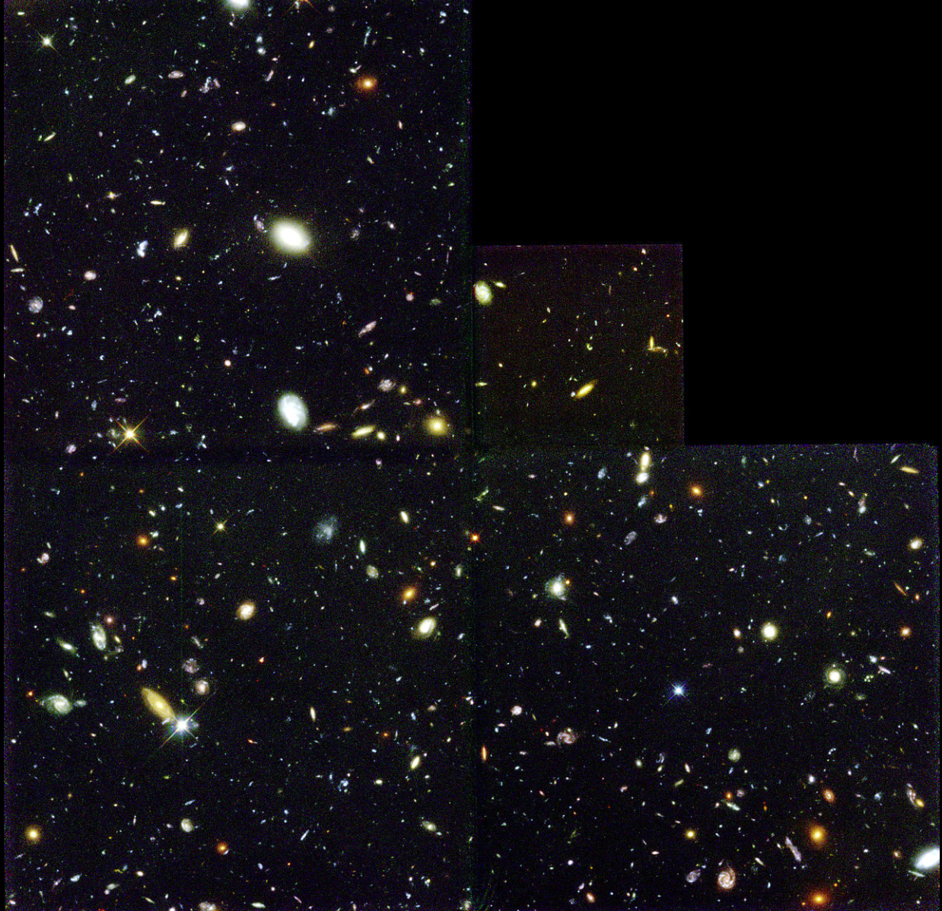
Mighty redwoods from little seedlings grow
2.6 arcmin

Slide 4
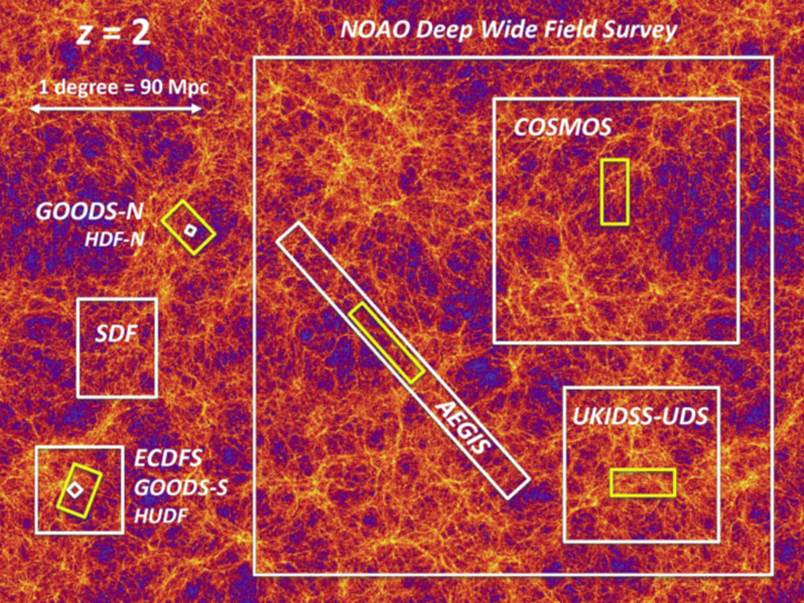
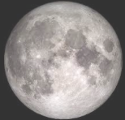
Bkgd: MultiDark Cosmological N-Body
Simulation (43Mpc thick, dz=0.03)
Credit: Ned Wright

Slide 5
Two Take-Away Messages
We remain far from understanding the origins, assembly, structure, motions, environments, etc. of gas, dust, stars, and SMBH in galaxies.
If you want to research the evolution of galaxies or AGN (outside of rich clusters), go to the CANDELS fields.
Notes:
For the young astronomers that can resist the lure of discovering new planets, there is plenty of space in observations or theory to make your mark in the study of the distant Universe. Gas and dust are particularly poorly observed at this time. Regardless, the place to start the research would be the CANDELS fields.

Slide 6
Outline
Why get yet more data on distant galaxies?
What is CANDELS: HST legacy survey of 5 famous fields with unsurpassed rich data
Some Results from CANDELS’ at High Noon
  What did Milky Way progenitors look like then?
  Are the host galaxies of AGNs major mergers?
  Serendipity discovery of bursting dwarfs?
Recap CANDELS and its legacy for future distant galaxy research

Slide 7
Why need for more data?
COSMIC VARIANCE & ENVIRONMENT

Slide 8
Bkgd: MultiDark Cosmological N-Body
Simulation (43Mpc thick, dz=0.03)
Credit: Ned Wright

Slide 9
Why need for more data?
COSMIC VARIANCE & ENVIRONMENT
LARGE RANGE in time or redshift, so many slices are needed to track evolution
EACH SLICE is a different place, so connecting objects from one to another epoch is a statistical study, if objects do not naturally fall into clear, separate categories

Slide 10
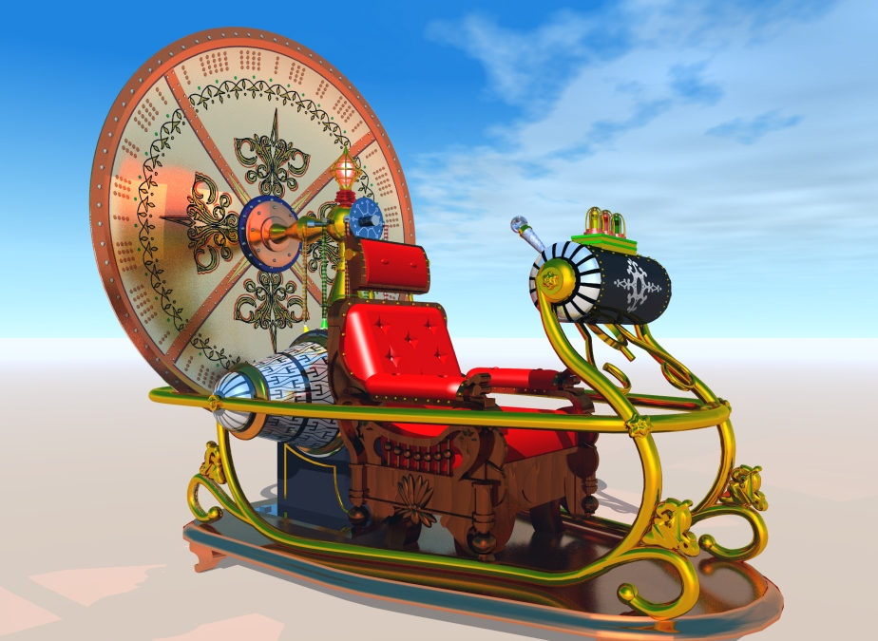
H. G. Wells: The Time Machine
Sees the same place at different times.
Published in 1894
Notes:
Pop Quiz for kids:
If you could travel on your photon light beam rocket ship, how many times could you reach SF and back in 1 hour? 10 million times
Light travels at 670 million miles per hour (or some may remember from high school or reading 186,000 miles per second)
Though light travels very fast, it is still finite. Everytime you see something, you are looking back in time, usually not by much.
For the golden gate bridge, about 1/10millionth of a second ago.. For the moon about 1 sec, for the sun about 8 minutes..
Thus we are looking more and more back in time the farther we “see” something. With big telescopes, and like time machines, we can see back billions of years.
Thus astronomers are an especially privileged group of scientists,.. Unlike paleontologists who have to work so hard to reconstruct what dinosarus looked like from a fossils of bones, astronomers get to see directly what the dinosaurs look like alive and running around!
In that sense, telescopes are genuine time machines… not as pretty or capable, not as versatile as HG Well’s which gets to see the present place back in time or the future, but nonetheless still a very powerful tool for science.

Slide 11
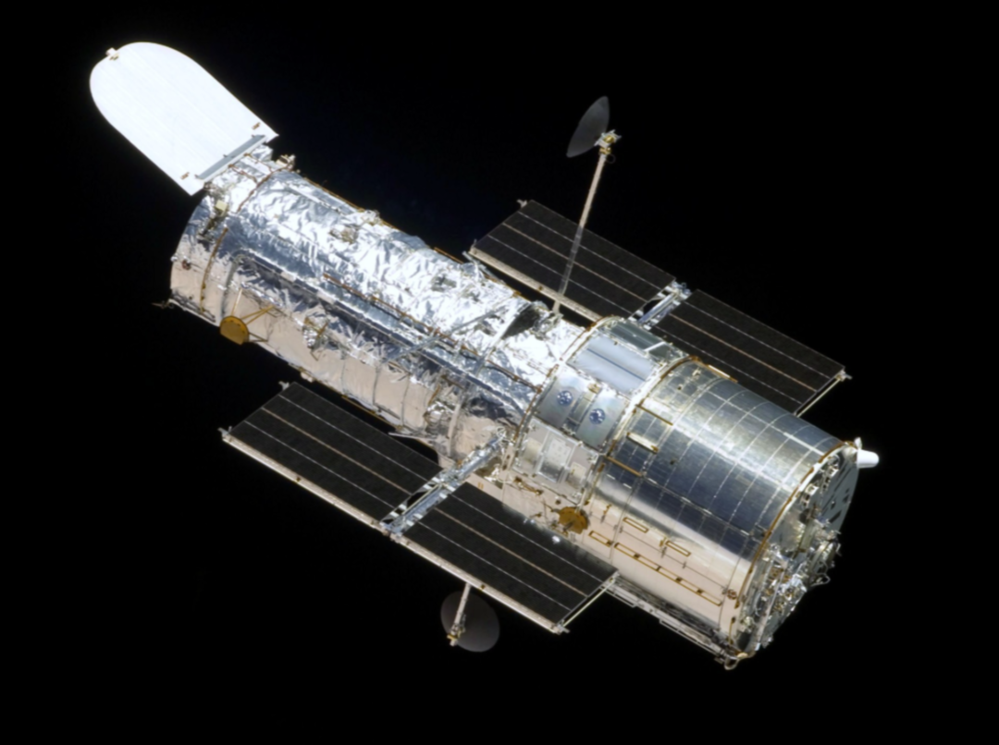
Telescope as a Time Machine
See
different places at the same time or
for the same spot in the sky, see different places at different times

Slide 12
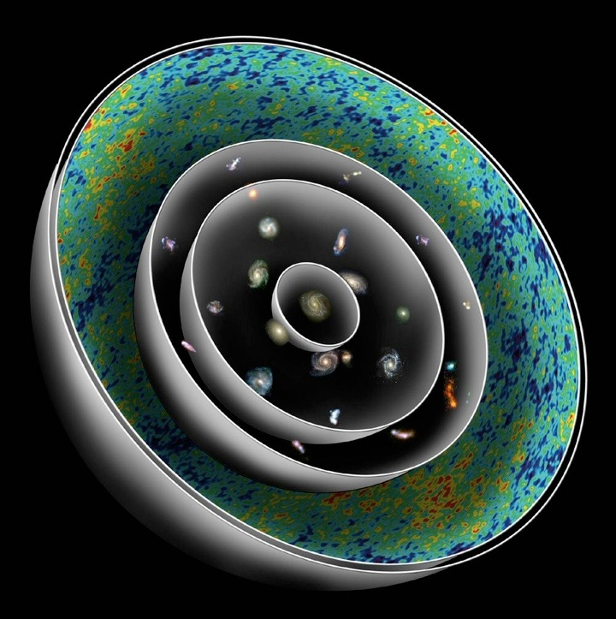
Cosmic Horizon (The Big Bang)
Cosmic Background Radiation
Cosmic Dark Ages
Bright Galaxies Form
Big Galaxies Form
Earth Forms
Today
When we look out in space we look back in time, but for different places
Cosmic Spheres
of Time
Credit: J. Primack
Notes:
J: Looking out in space is looking back in time, because it takes light so long to get here from far away. Today is the center, and each sphere as you go out represents an earlier epoch in the history of the universe. Notice that near the center where we are, galaxies look much like our home Milky Way. But as you go back in time, you see what early galaxies look like. They are small but very bright because they are very dense and forming stars at a high rate. (The universe itself was much denser then. The universe has expanded by a factor of about 7 since the light left the earliest galaxies whose redshift distance we can measure, which means that its density was 343 times greater then.) Beyond them we see the heat radiation from the big bang. Slightly beyond that is the cosmic horizon – the big bang itself.
N: Imagine that runners from ancient Greece were just arriving today, breathless, carrying the news of the defeat of the Persians, and we were the first to hear it from their lips. Runners are coming from all over the universe with news of their eras, in every form of radiation and the strangest languages anyone’s ever heard; the cosmological revolution is human beings finally beginning to understand and put the whole story together.
We are at the center of the Cosmic Spheres of Time, and this symbol ties together all these ideas and immerses us in them: that the universe is expanding; that the speed of light is the limiting speed for everything but space; that looking out into space is looking back in time; that the universe evolves and is very different from what it was in the beginning and will be in the future; and that human (or intelligent alien) consciousness is an essential element of what makes a visible universe. The small version of the Cosmic Spheres at left is a little icon to remind us of all these things.
This is a whole new way that we are central to the universe. Every world is central to its own visible universe. When we represent the unvierse this way, with us at the center, we begin to see what it means to be part of our universe. Of course we could think of ourselves as outside the universe, but this is actually inaccurate. We’re in it, and we’re the center of the visible universe, by definition. This perspective is a choice. We call looking at the universe this way “the Meaningful Universe,” and looking at it from the outside as “the Existential Universe.” This distinction, it turns out, makes all the difference.
Now we’re going to show you another way that we are central or special in the expanding universe, based on what we are made of.
Then we’ll show how we – and any intelligent life – are central between the largest and smallest size.

Slide 13
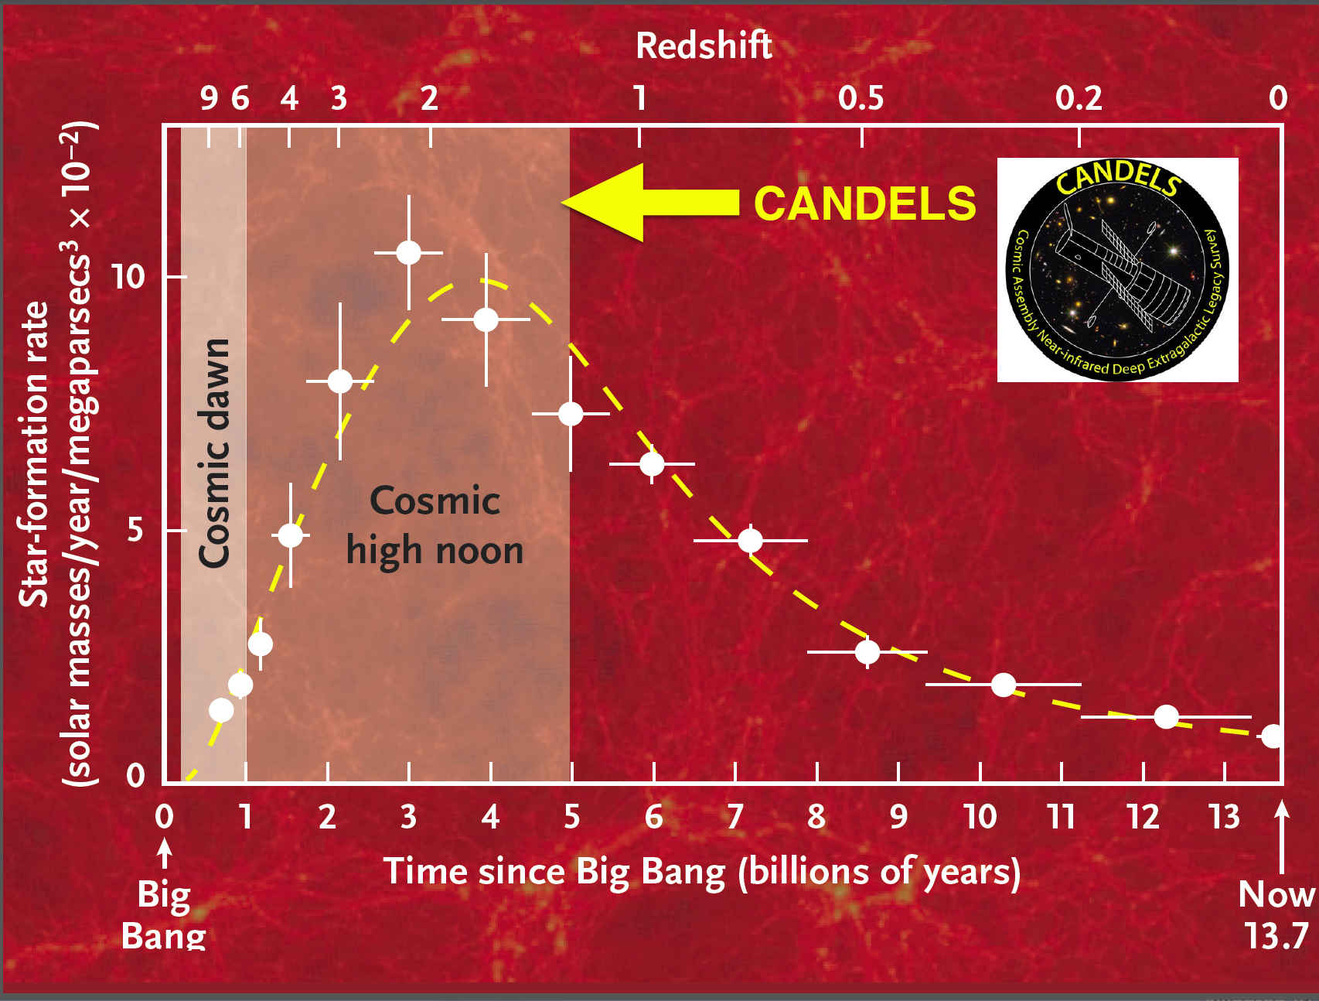
Cosmic
afternoon

Slide 14
Why need for more data?
COSMIC VARIANCE & ENVIRONMENT
LARGE RANGE in time or redshift, so many slices are needed to track evolution
EACH SLICE is a different place, so connecting objects from one to another is a statistical study if objects do not naturally fall into clear, separate categories
GALAXIES in fact are incredibly diverse with huge range in physically relevant, non-discrete parameters: Mass, Size, Star Formation Rate, Structure and Substructure, Shapes/Morphology, proportion of key constituents (stellar mass, gas in various phases and ionizations, dust, SMBH), assembly and interaction history, kinematics, etc

Slide 15
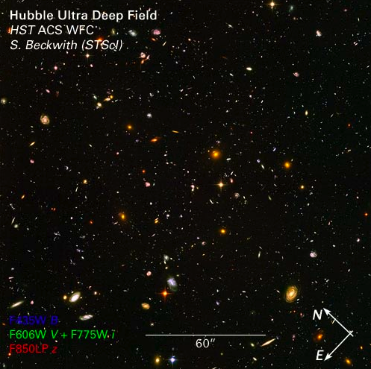
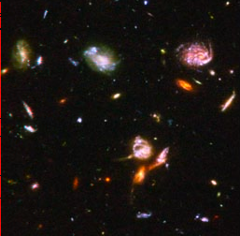
HST UDF Showing High Density &
Diversity of Galaxy Substructures
30”

Slide 16
Why need for more data?
COSMIC VARIANCE & ENVIRONMENT
LARGE RANGE in time or redshift, so many slices are needed to track evolution
EACH SLICE is a different place, so connecting objects from one to another is a statistical study if objects do not naturally fall into clear, separate categories
GALAXIES in fact are incredibly diverse with huge range in many parameters that may vary independently, making connecting one time-space slice hard to connect to another
Many rare but important objects/situations: AGNs, lensed objects, rich clusters, galaxies in voids, very short-duration infrequent events (SN), etc.

Slide 17
Why need for more data? Recap
COSMIC VARIANCE & ENVIRONMENT
LARGE RANGE in time or redshift
EACH SLICE is a different place, so solid statistical connections require large samples.
GALAXIES are incredibly diverse with huge range in many non-discrete parameters
Many rare or extreme (few %) but important objects/situations
SDSS has nearly a million galaxies and key questions remain unanswered due to samples being too small. As one example, how closely do Milky Way counterparts by mass, SFR, and environment match our own home galaxy in structure, gas, and AGN activity?
Notes:
Having established that there are many compelling reasons for larger and deeper and richer surveys of distant galaxies, let me tell you about the best survey so far and by far: CANDELS

Slide 18
Outline
Why get yet more data on distant galaxies?
What is CANDELS: HST legacy survey of 5 famous fields with unsurpassed rich data
Some Results from CANDELS’ at High Noon
  What did Milky Way progenitors look like then?
  Are the host galaxies of AGNs major mergers?
  Serendipity discovery of bursting dwarfs?
Recap CANDELS and its legacy for future distant galaxy research

Slide 19
What is CANDELS?
Multi-cycle HST Treasury Survey (2010) comprised of 902 orbits of mostly the Near-IR camera WFC3 with the optical ACS imaging taken in parallel (& some UV and grism). Completed in fall 2013.
Now umbrella name for its 5 famous fields that have served as magnets for enormous and very rich data
Notes:
CANDELS is intentionally misspelled so that it can easily be found via web search engines – name was major issue for the team and decided by voting.

Slide 20
CANDELS in a Nutshell
Imaging data in 5 fields for 250,000 galaxies from z = 1.5 - 8: Wide and Deep
WFC3 improves photometric-redshifts out to z ~ 2.5 and better penetrates dust
Spitzer Extended Deep Survey (SEDS): IRAC 26 AB (5-σ); means stellar masses can be measured to ~10⁹ M_{o} to redshifts z ~ 7
Overlapping ACS parallels: yield panchromatic imaging needed for photo-z’s
X UV in GOODS-N: 100 orbits of two UV filters (F275W, F335W)
X Every pointing observed at least twice: allows search for variable AGN and first SNe beyond z ~ 1.5
MAIN CANDELS HST INFORMATION:
Redshifts, Stellar Masses, SFR, Sizes, Extinction, & Morphologies
Bread & Butter for Galaxy Evolution Research

Slide 21
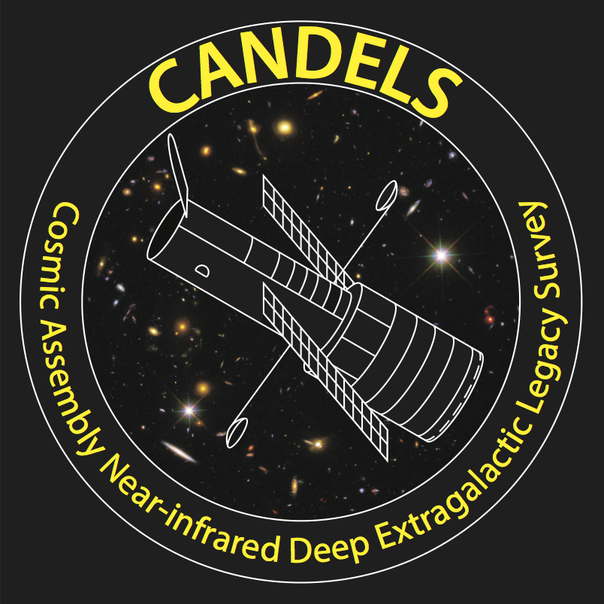
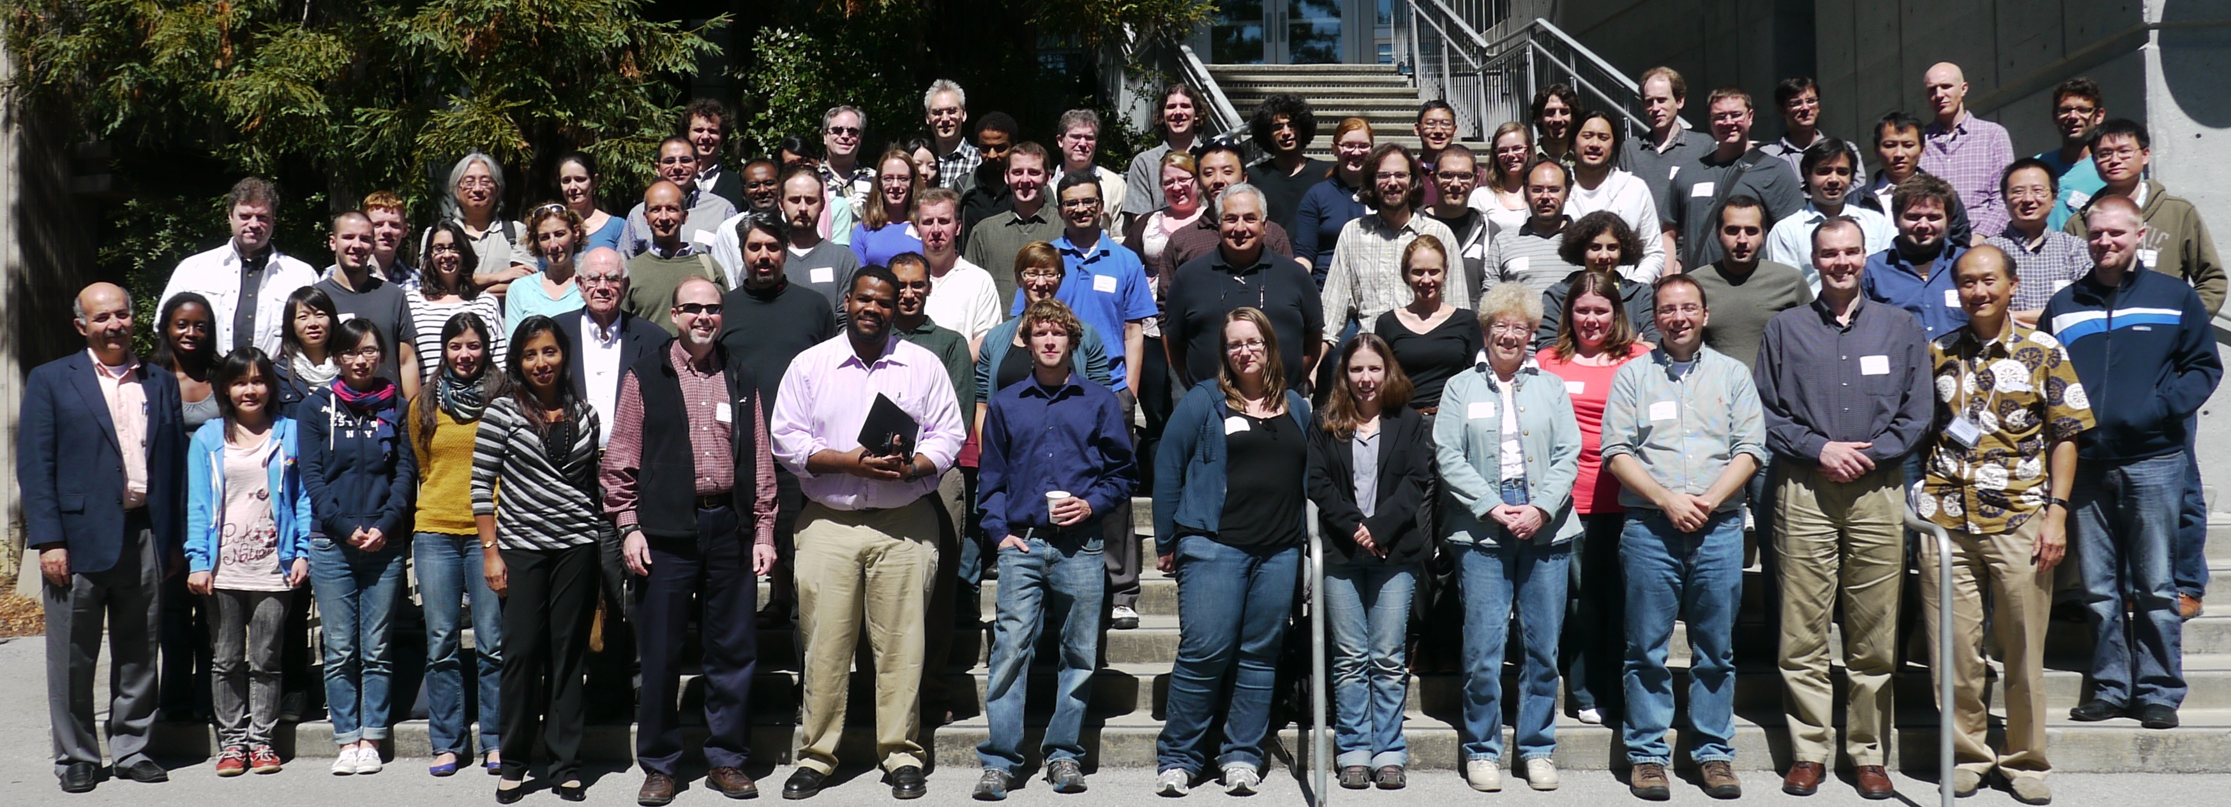

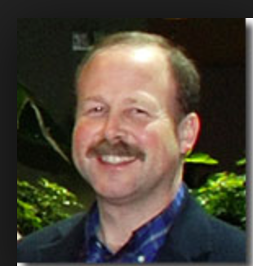
CANDELS
Cosmic Assembly Near-infrared Deep Extragalactic Legacy Survey
Co-PIs:
Sandra Faber & Harry Ferguson
~200 team members
~45 institutions
> 100 papers
12 countries
Builders:
Norman Grogin, Dale Kocevski
Anton Koekemoer, Adam Riess, Steve Rodney
candels.ucolick.org
Notes:
When I started doing research on faint galaxies, we had groups of perhaps 2 or 3 people. Today, it is another world – communications and policies that are clear and fair are very challenging.
A unique aspect of the large CANDELS team is that the senior executives stress the careers of junior scientists and give them leadership position on major working groups.

Slide 22
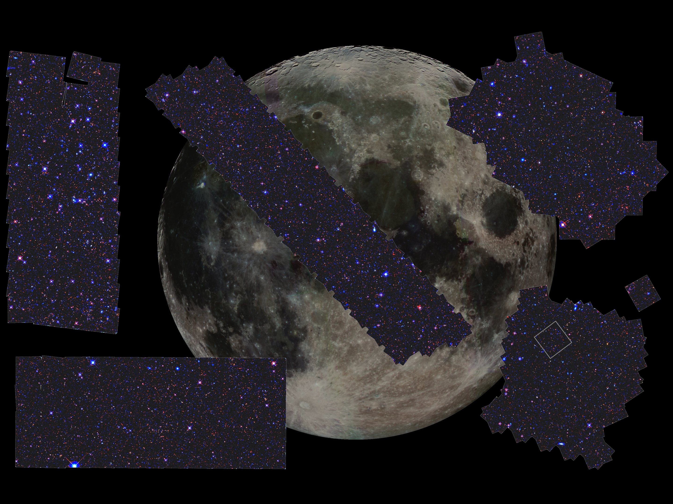
Five regions, 900 orbits. Observations were completed August 2013.
GOODS-N
14’x10’
COSMOS
22’x8’
HDF
DEEP
WIDE
EGS
30’x6’
WIDE
HUDF
DEEP
WIDE
UDS
22’x8’
GOODS-S
10’x13’
Grogin+ 11
Koekemoer+ 11

Slide 23

CANDELS Exposure Strategy
250,000 galaxies ~2x10⁶ Mpc³ per unit z for z>1.5
“Wedding cake” strategy: three layers of J+H
UDFs: ~100 orbit depth over ~10 sq arcmin
DEEP: 8 orbit depth over ~120 sq arcmin
WIDE: 2 orbit depth over ~700 sq arcmin
Notes:
+ Proposals sufficiently similar to combine, but different enough to make Phase II interesting.
+ Overall strategy is that of a wide plus deep wedding cake approach
+ Wide+Deep allows us to efficiently sample both rare/bright and faint/common extragalactic objects.
23

Slide 24
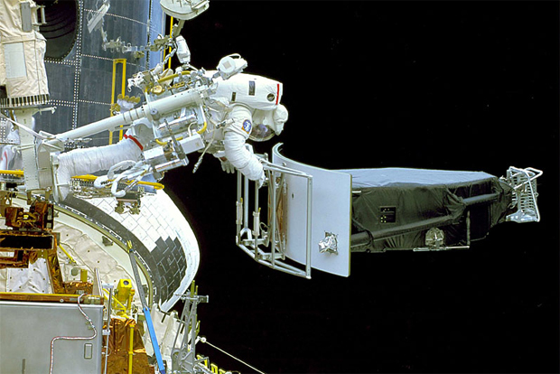
Astronaut Andrew Feustel installing Wide Field Camera Three
on the last visit to Hubble Space Telescope in 2009
The infrared capabilities of WFC3
allow us to see the full stellar
populations of forming galaxies

Slide 25

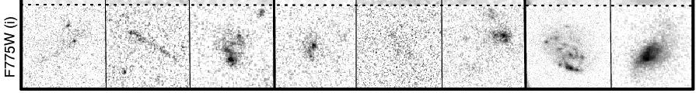
What The Hubble Near-Infrared
(Wide Field Camera 3: WFC3) Imaging Can See that Optical Cannot
HST OPTICAL IMAGES (in RED FILTER)
of 8 VERY FAINT DISTANT GALAXIES
(Couple Orbits Depth)
Notes:
+ That Being said, when we look at high-z systems we see sig evolution in populations.
+ One of the first things people noticed when they started looking at high-z clusters is an increased fraction of blue late-type galaxies in higher redshift cluster (well known BO effect)
+ This increase is part of an overall evolution in the morph-density relationship. There is an increased late-type fraction at all local densities at higher redshifts. This increase is at the expense of the S0 population, which shows a decreased fraction. The elliptical population remains constant, consistent with the scenario that they are primordial and in place perhaps as early as z~3.
+ In conjunction with this morph evolution, we see evidence of the red sequence building up as higher redshift clusters show a deficit of faint red galaxies relative to local clusters. Evidence that spirals -> S0 -> faint end of red sequence.
+ Evidence of increased star formation and nuclear activity seen in over density of radio and x-ray sources.
25

Slide 26
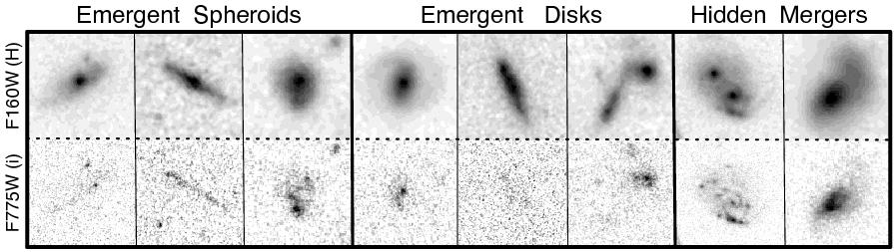
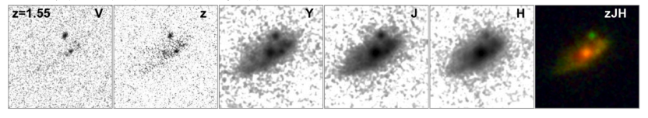
Adding Images in the
Near-Infrared (1.6 micron)
See New Aspects of the Galaxies
Images of One Galaxy for 5 Filters
2 Optical (V,z) and 3 Infrared (Y, J, H)
Notes:
+ That Being said, when we look at high-z systems we see sig evolution in populations.
+ One of the first things people noticed when they started looking at high-z clusters is an increased fraction of blue late-type galaxies in higher redshift cluster (well known BO effect)
+ This increase is part of an overall evolution in the morph-density relationship. There is an increased late-type fraction at all local densities at higher redshifts. This increase is at the expense of the S0 population, which shows a decreased fraction. The elliptical population remains constant, consistent with the scenario that they are primordial and in place perhaps as early as z~3.
+ In conjunction with this morph evolution, we see evidence of the red sequence building up as higher redshift clusters show a deficit of faint red galaxies relative to local clusters. Evidence that spirals -> S0 -> faint end of red sequence.
+ Evidence of increased star formation and nuclear activity seen in over density of radio and x-ray sources.
26

Slide 27
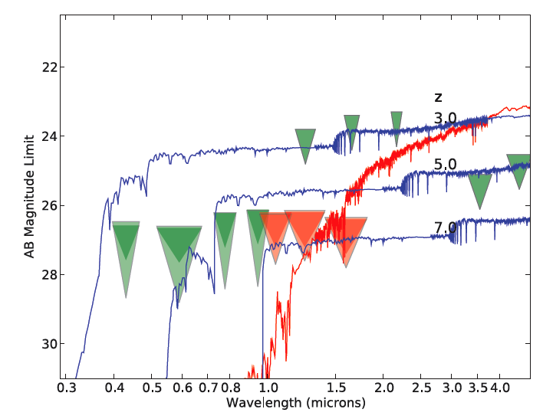
New YJH photometry limits in GOODS-S Deep region
Existing HST and ground
Notes:
+ That Being said, when we look at high-z systems we see sig evolution in populations.
+ One of the first things people noticed when they started looking at high-z clusters is an increased fraction of blue late-type galaxies in higher redshift cluster (well known BO effect)
+ This increase is part of an overall evolution in the morph-density relationship. There is an increased late-type fraction at all local densities at higher redshifts. This increase is at the expense of the S0 population, which shows a decreased fraction. The elliptical population remains constant, consistent with the scenario that they are primordial and in place perhaps as early as z~3.
+ In conjunction with this morph evolution, we see evidence of the red sequence building up as higher redshift clusters show a deficit of faint red galaxies relative to local clusters. Evidence that spirals -> S0 -> faint end of red sequence.
+ Evidence of increased star formation and nuclear activity seen in over density of radio and x-ray sources.
27

Slide 28
New YJH photometry limits in GOODS-S Deep region
New WFC3
CANDELS IRAC
Notes:
+ That Being said, when we look at high-z systems we see sig evolution in populations.
+ One of the first things people noticed when they started looking at high-z clusters is an increased fraction of blue late-type galaxies in higher redshift cluster (well known BO effect)
+ This increase is part of an overall evolution in the morph-density relationship. There is an increased late-type fraction at all local densities at higher redshifts. This increase is at the expense of the S0 population, which shows a decreased fraction. The elliptical population remains constant, consistent with the scenario that they are primordial and in place perhaps as early as z~3.
+ In conjunction with this morph evolution, we see evidence of the red sequence building up as higher redshift clusters show a deficit of faint red galaxies relative to local clusters. Evidence that spirals -> S0 -> faint end of red sequence.
+ Evidence of increased star formation and nuclear activity seen in over density of radio and x-ray sources.
28

Slide 29
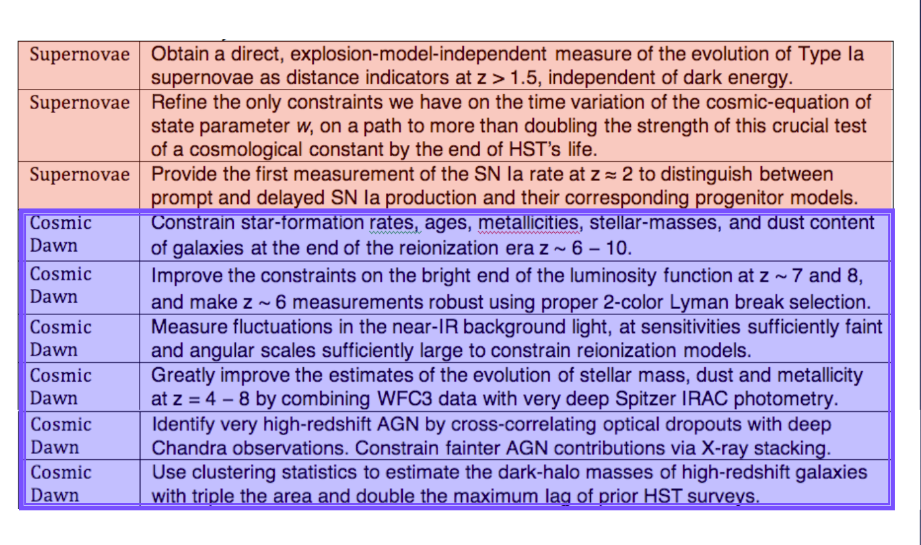
SCIENCE GOALS (ORIGINAL)

Slide 30
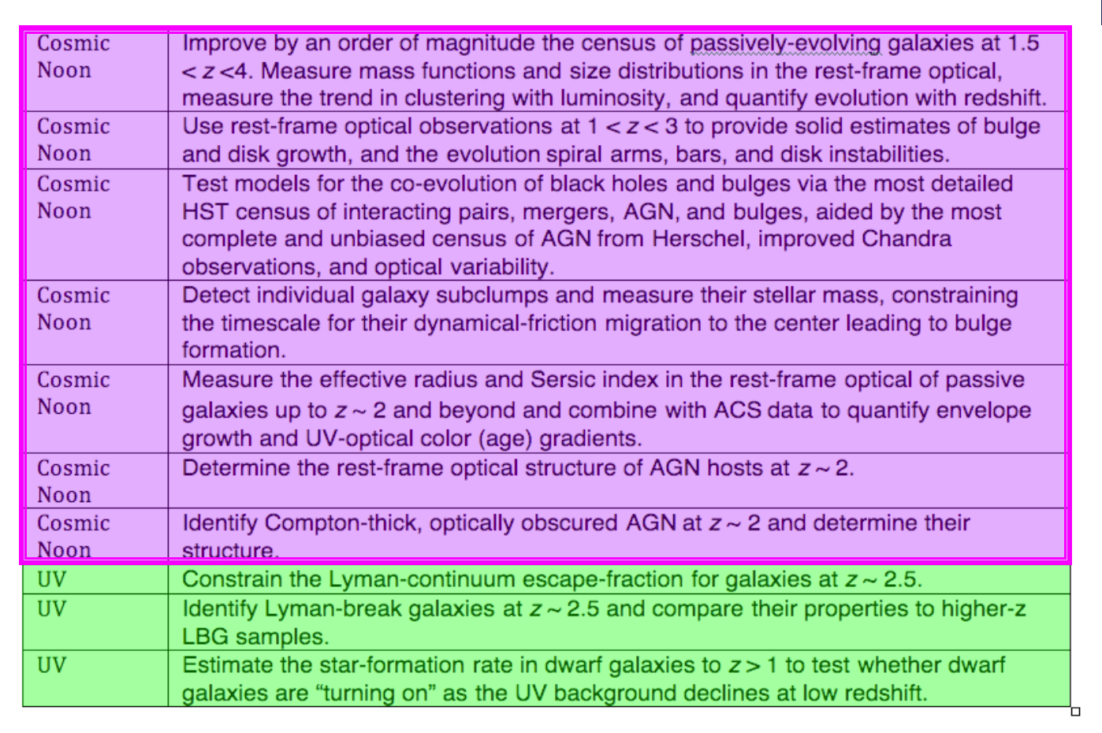
SCIENCE GOALS (ORIGINAL)

Slide 31
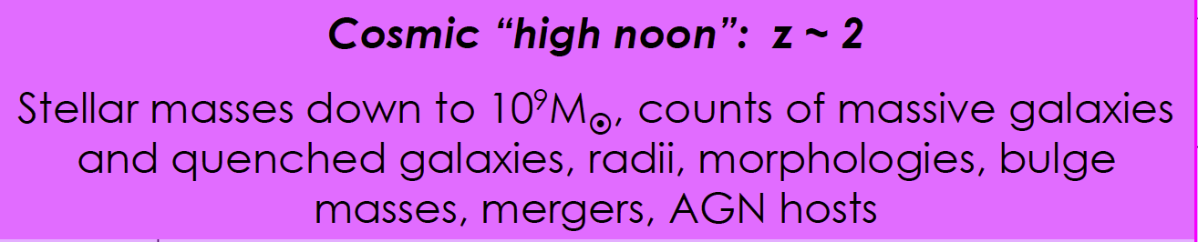
SCIENCE GOALS (ORIGINAL)

Slide 32
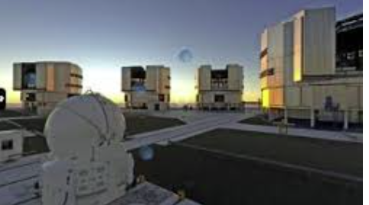
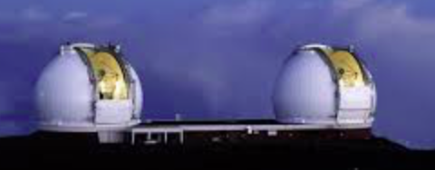
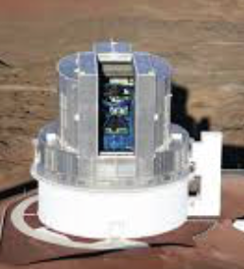
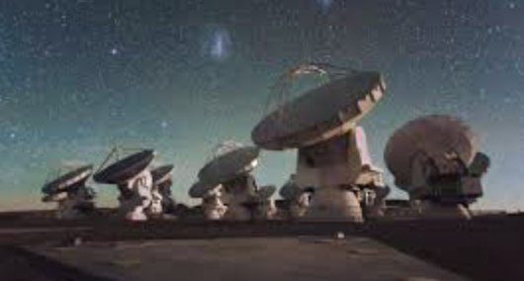
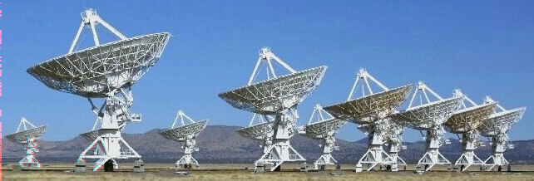
CANDELS fields also include the deepest and largest allocations of multi-band imaging and spectroscopy from the largest and best ground telescopes
VLT
Keck
Subaru
ALMA
VLA

Slide 33
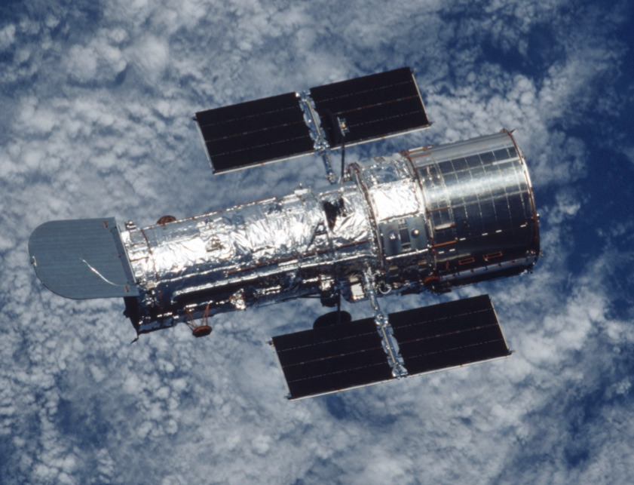
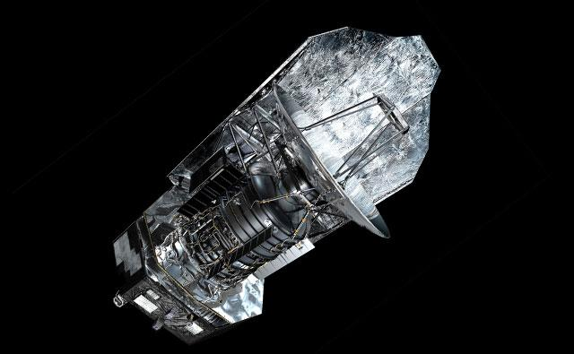
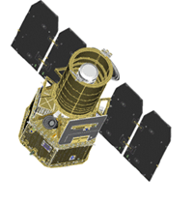
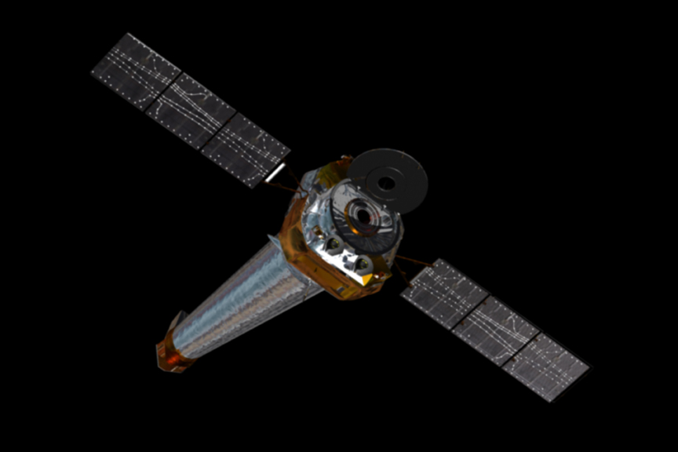
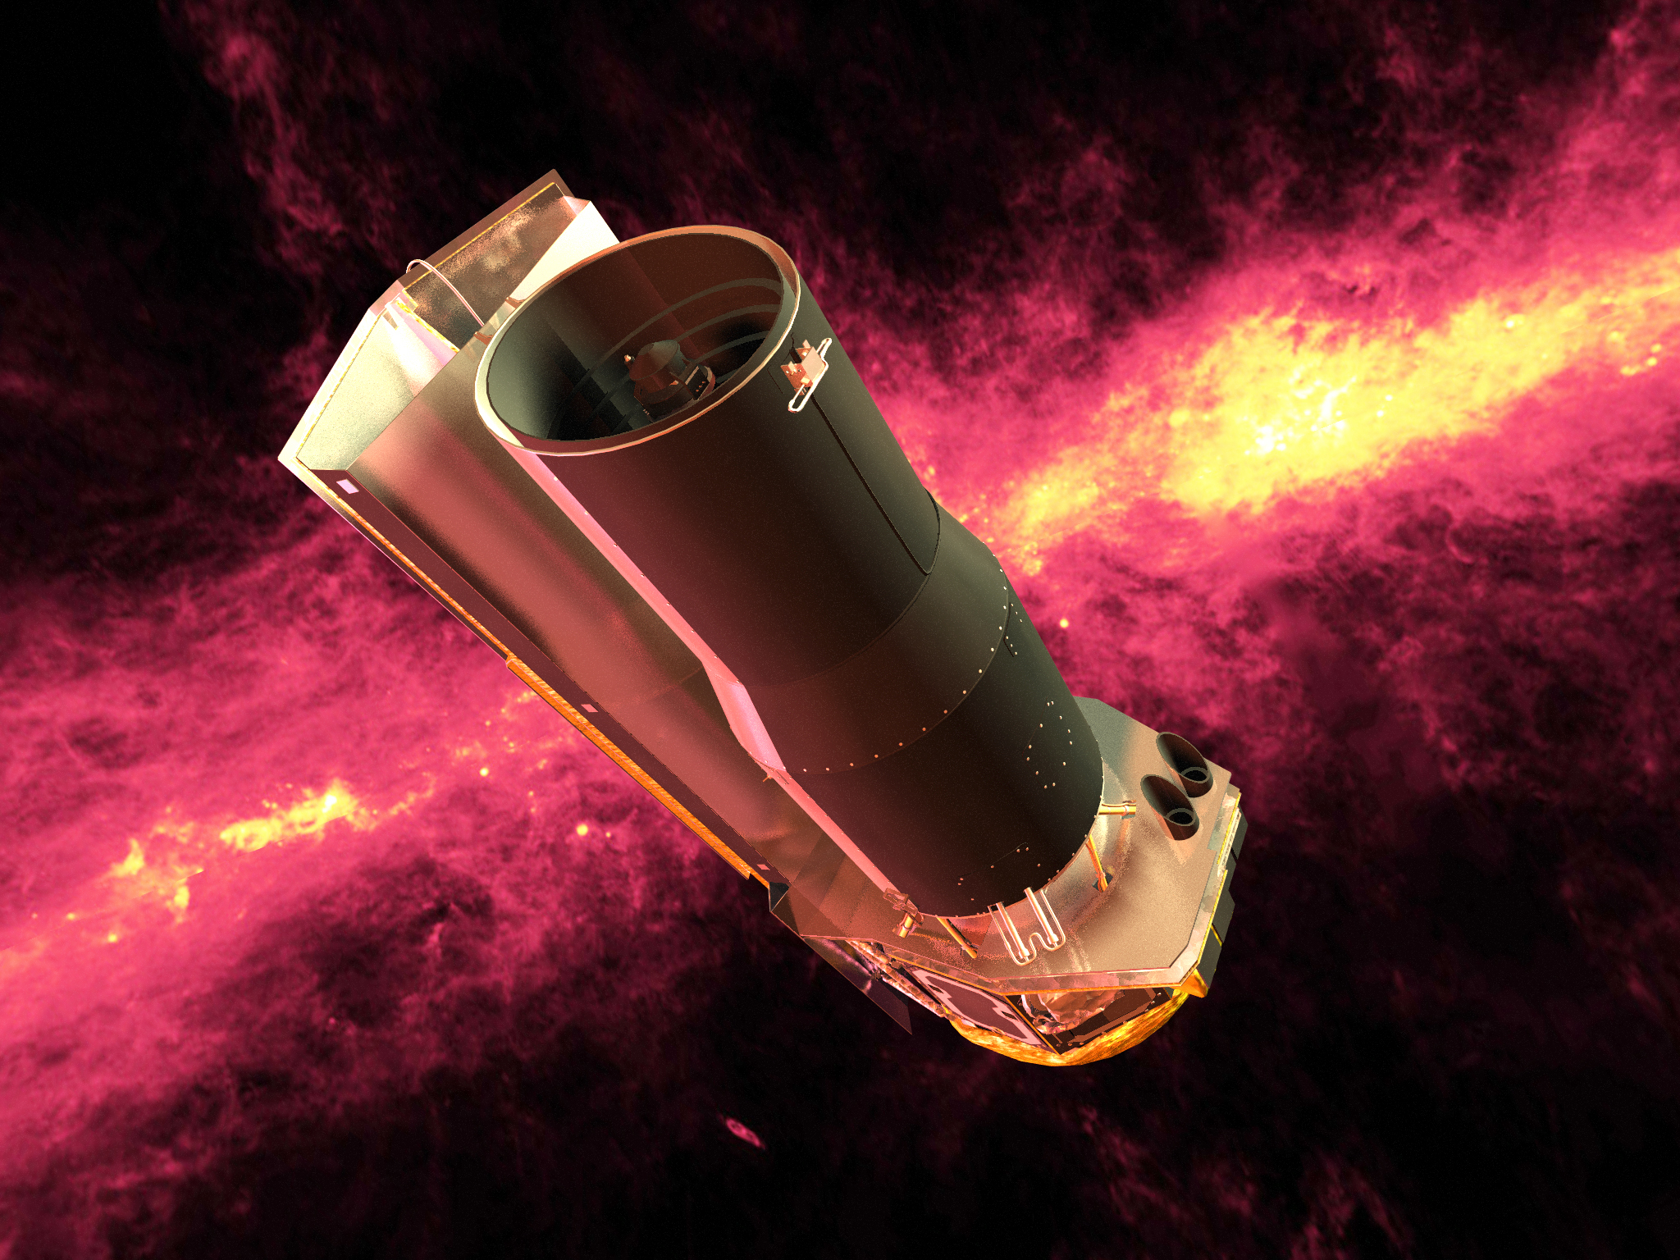
CANDELS fields have the very deepest multi-wavelength data from space
Herschel Far-IR
HST Optical – Near IR
GALEX (UV)
Chandra X-RAY
Spitzer Mid-Far IR
Notes:
Special thanks to NASA for developing the Great Observatories program – except for the Compton Gamma Ray Obs (CGRO), the others have all played a critical role for the study of distant galaxies (Spitzer, HST, Chandra)

Slide 34
Example of Chandra/ACIS contribution
GOODS-S: 7 Ms
GOODS-N: 2 Ms
EGS: 0.8 Ms
UDS: 0.6 Ms
COSMOS: 0.18 Ms
TOTAL EXPOSURE TIME: 10.58 Ms = 2,938 hours
This superb set of super-deep X-ray data will not be surpassed for at least another 10 years!
So CANDELS is the go-to survey regions
to study AGN evolution

Slide 35
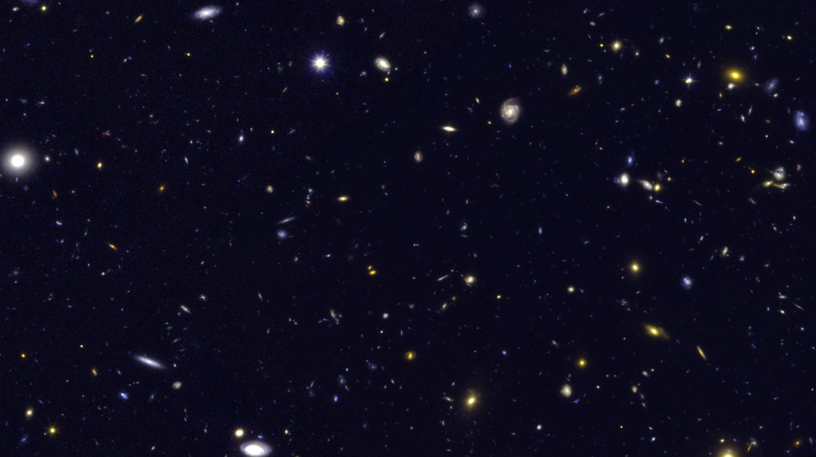
HST
0.6, 1.25, 1.6 μm

Slide 36
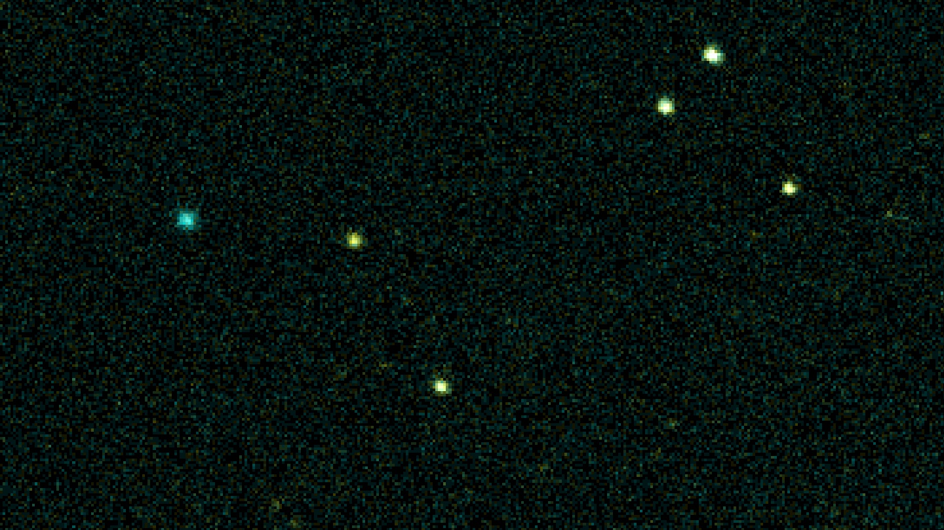
Chandra
0.5-2, 2-8, 5-8 keV

Slide 37
HST
0.6, 1.25, 1.6 μm
Here are ID’s of the 6 brightest Chandra sources

Slide 38
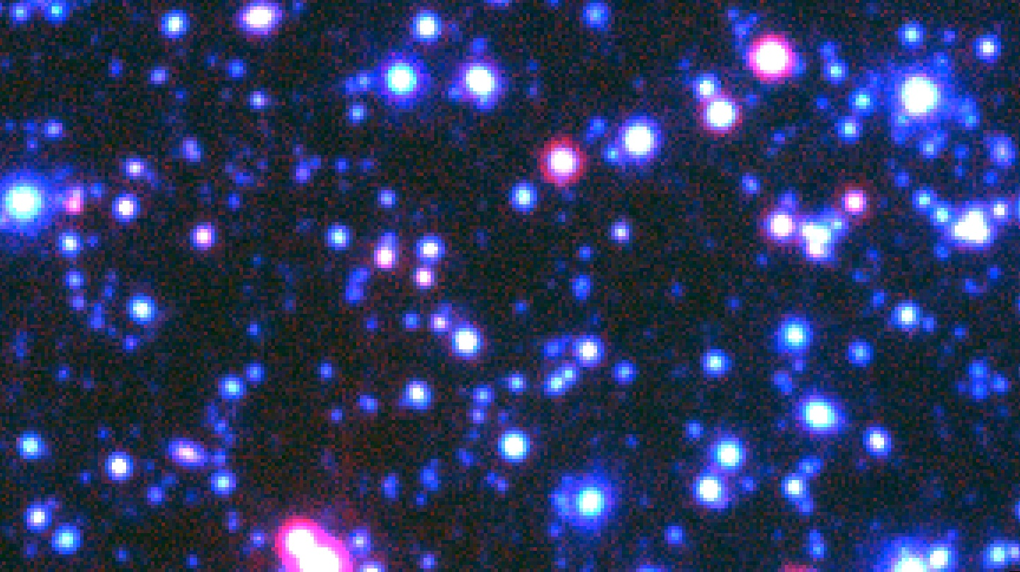
Spitzer/IRAC
3.6+4.5, 5.6, 8 μm
Notes:
For completeness, it is worth showing how the same piece of sky looks with the addition of longer wavelengths from mid-IR using IRAC on Spitzer to the Far IR using Herschel.

Slide 39
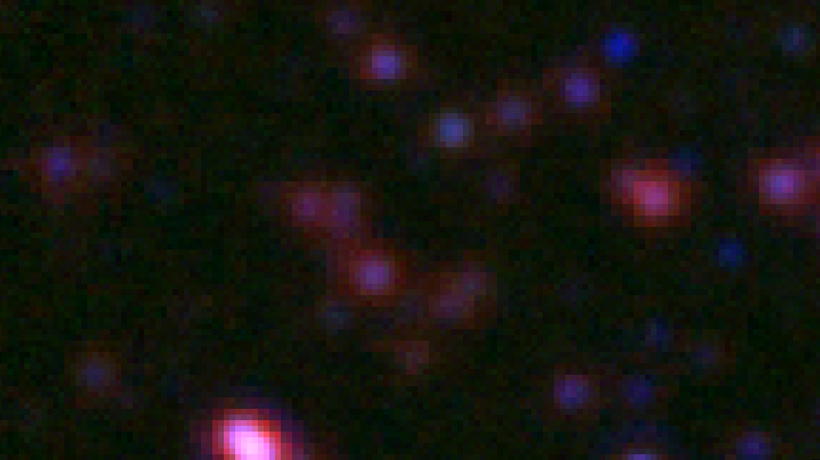
Spitzer/MIPS + Herschel/PACS
24, 100, 160μm

Slide 40

Herschel/SPIRE
250, 350, 500μm

Slide 41
Explore one of the main goals of CANDELS – the nature of the host galaxies of AGNs
Notes:
While we are focused on the extensive amounts of Chandra X-ray data, explore one of the science goals originally set out.

Slide 42
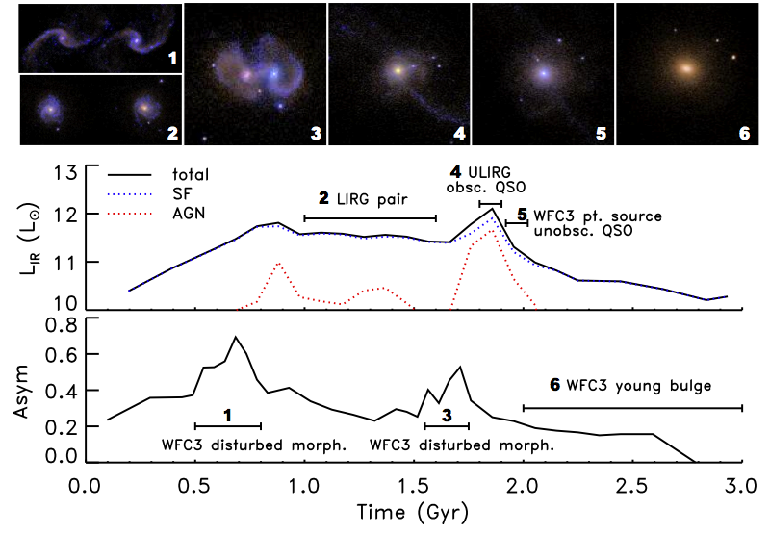
Mergers do not play a significant role in fueling the central supermassive black holes in most x-ray selected active galaxies at z~2.
Popular scenario: Merger ➔ ULIRG ➔ embedded QSO ➔ unobscurred AGN ➔ elliptical galaxy with black hole (e.g. Hopkins+ 06)
Notes:
42

Slide 43
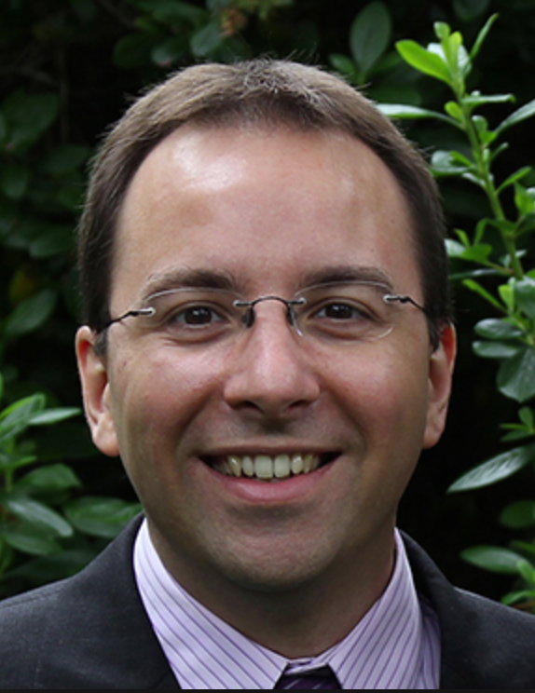
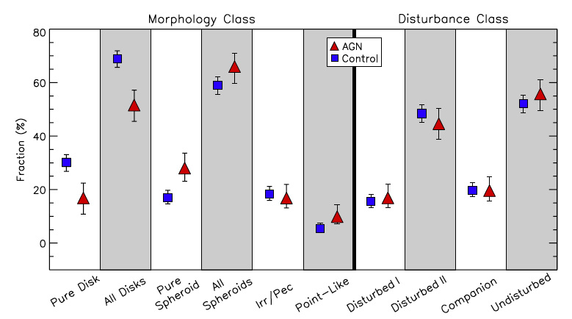
Mergers do not play a significant role in fueling the central supermassive black holes in most x-ray selected active galaxies at z~2.
AGN hosts are NOT disturbed.
Kocevski+12
Notes:
43

Slide 44
Mergers do not play a significant role in fueling the central supermassive black holes in most x-ray selected active galaxies at z~2.
AGN hosts are mostly spheroids.
Kocevski+12
Notes:
44

Slide 45
Mergers do not play a significant role in fueling the central supermassive black holes in most x-ray selected active galaxies at z~2.
AGN hosts often have disks.
Kocevski+12
Notes:
45

Slide 46
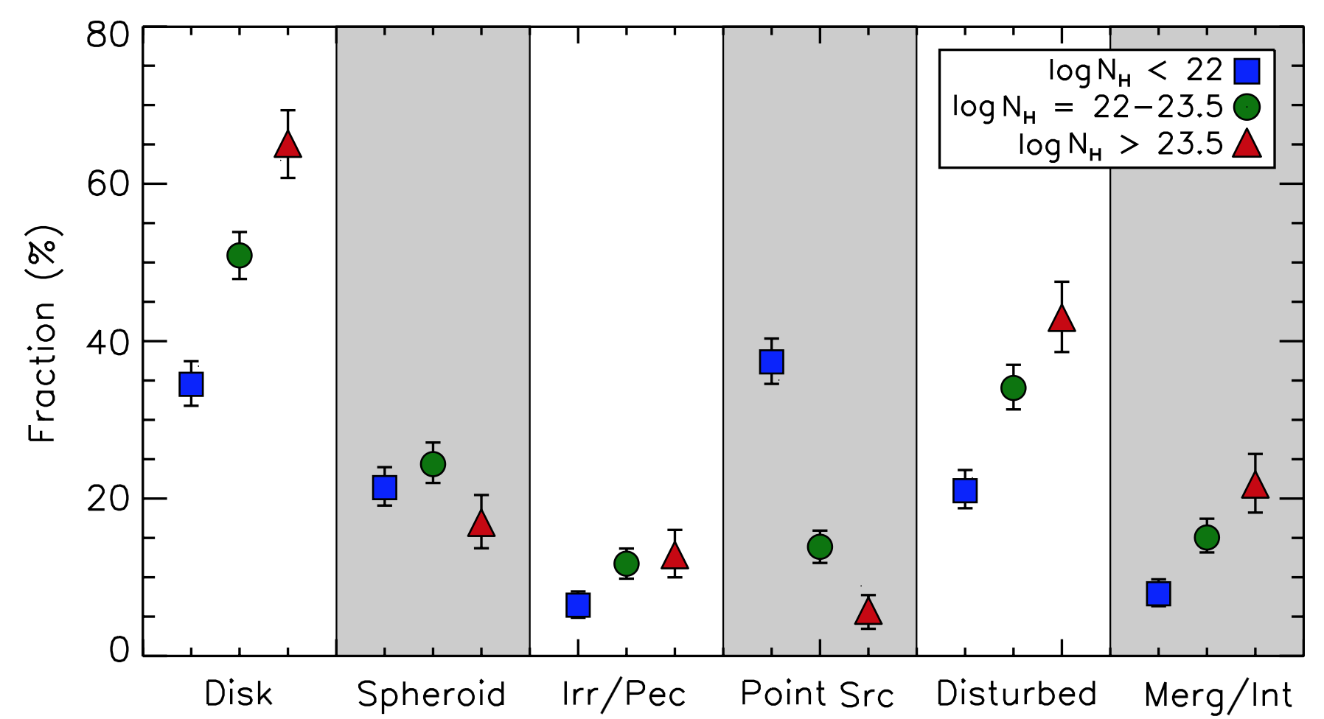
Hosts of Compton-thick (dusty) AGN are a bit more disturbed
AGN hosts have many disks.
Kocevski+15
Notes:
46

Slide 47
Mergers do not play a significant role in fueling the central supermassive black holes in most x-ray selected active galaxies at z~2.
Possible explanations:
  Mergers are important only for the most luminous AGN
  AGN at lower luminosities are internally triggered, e.g. by disk instabilities.
  X-ray AGN are seen at a late phase; AGN are dust obscured when the merger signatures are apparent
  Variability on timescales of 10²⁻⁶ years wipes out the expected correlations
Ongoing work to look at AGN frequency of hosts with different sizes: clear signal seen that AGN activity is dramatically increased during the host galaxy’s compact, star-forming phase
Notes:
Despite having the world’s best data, I hope you can see our survey is already being limited – in this case by the rarity and small numbers of the most luminous AGN and the need for more theoretical work.
47

Slide 48
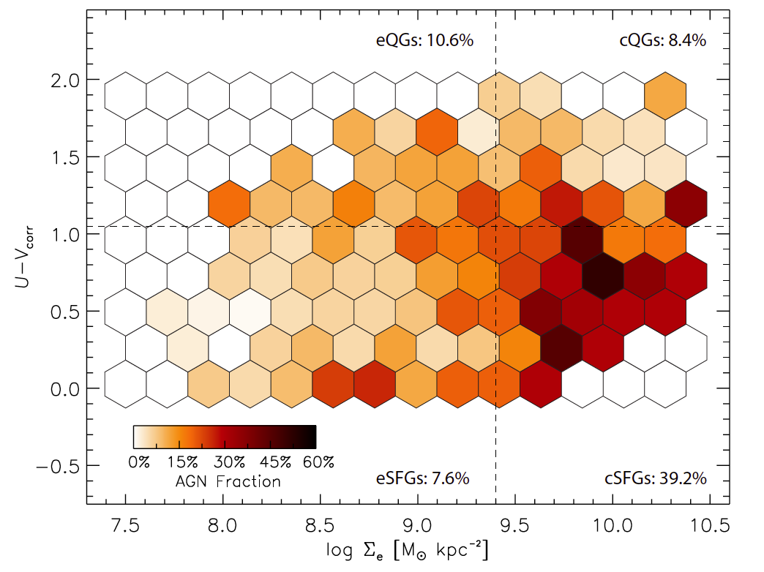
AGNs seen at 40% fraction during compact Star Forming stage
Extended Quiescent
Compact
Quiescent
Extended SF
Compact SF
Extended SF

Slide 49
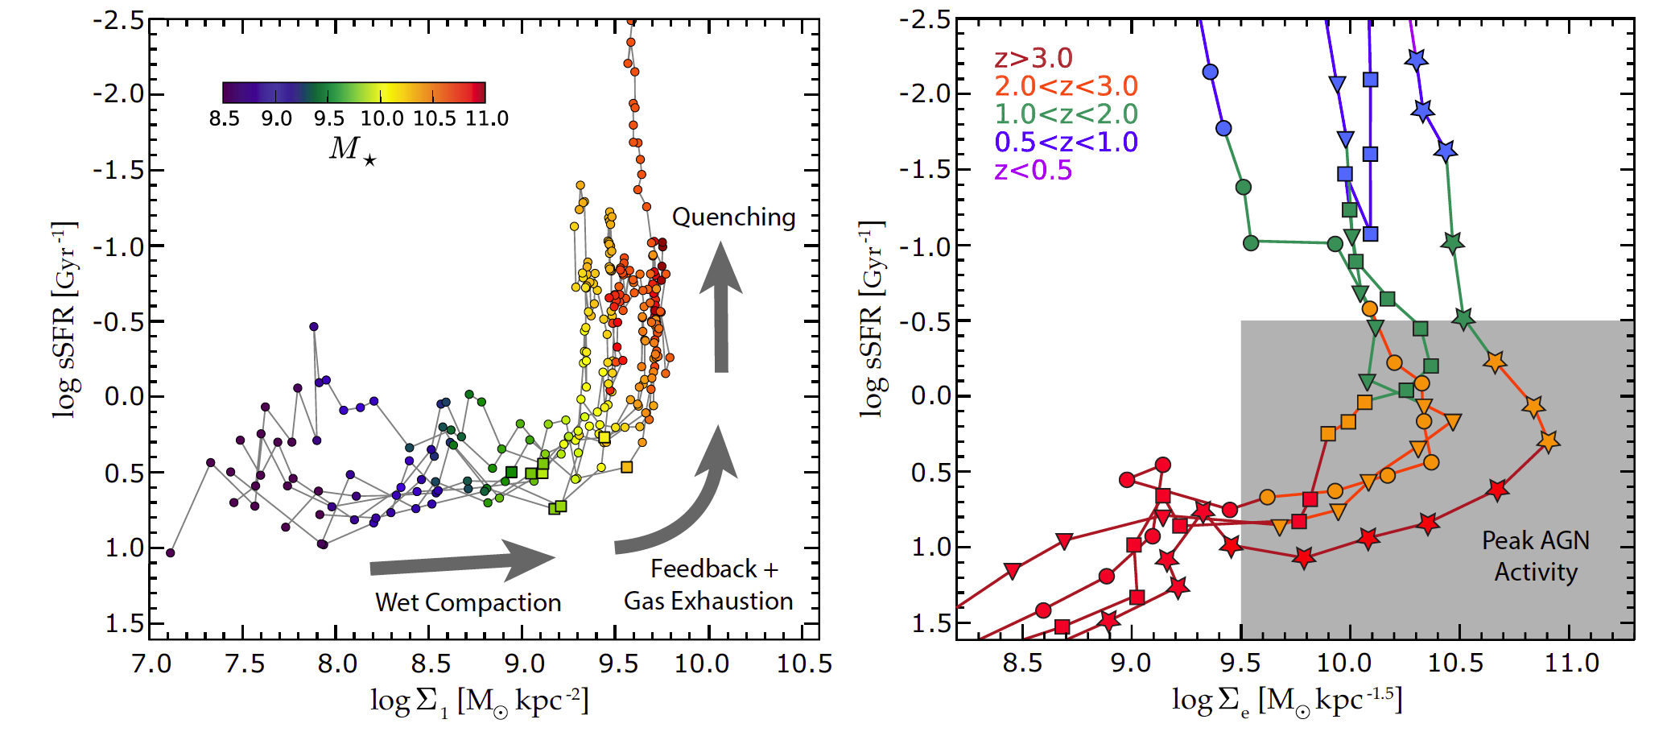
Vela Simulations Show that the compact phase is when feedback, perhaps from AGN, is needed for quenching galaxies

Slide 50
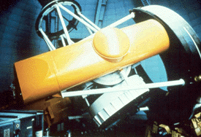
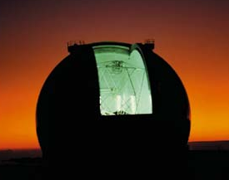
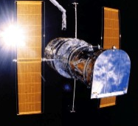
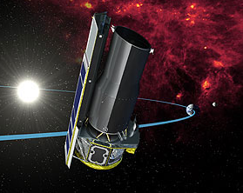
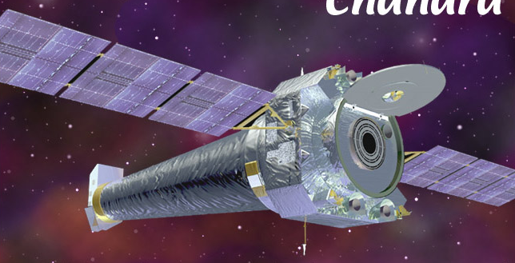
CFHT (Images)
Keck (Spectra)
Hubble (Optical)
Spitzer (IR)
GALEX (UV)
Chandra (X-ray)
VLA (Radio)
Notes:
X-rays allow study of radiation from SMBH
Spitzer allows study of dusty SF
Radio sees distant radio Quasars

Slide 52
An Important Component of the CANDELS program is the inclusion of top theorists working with N-body and hydrodynamical simulations.

Slide 53
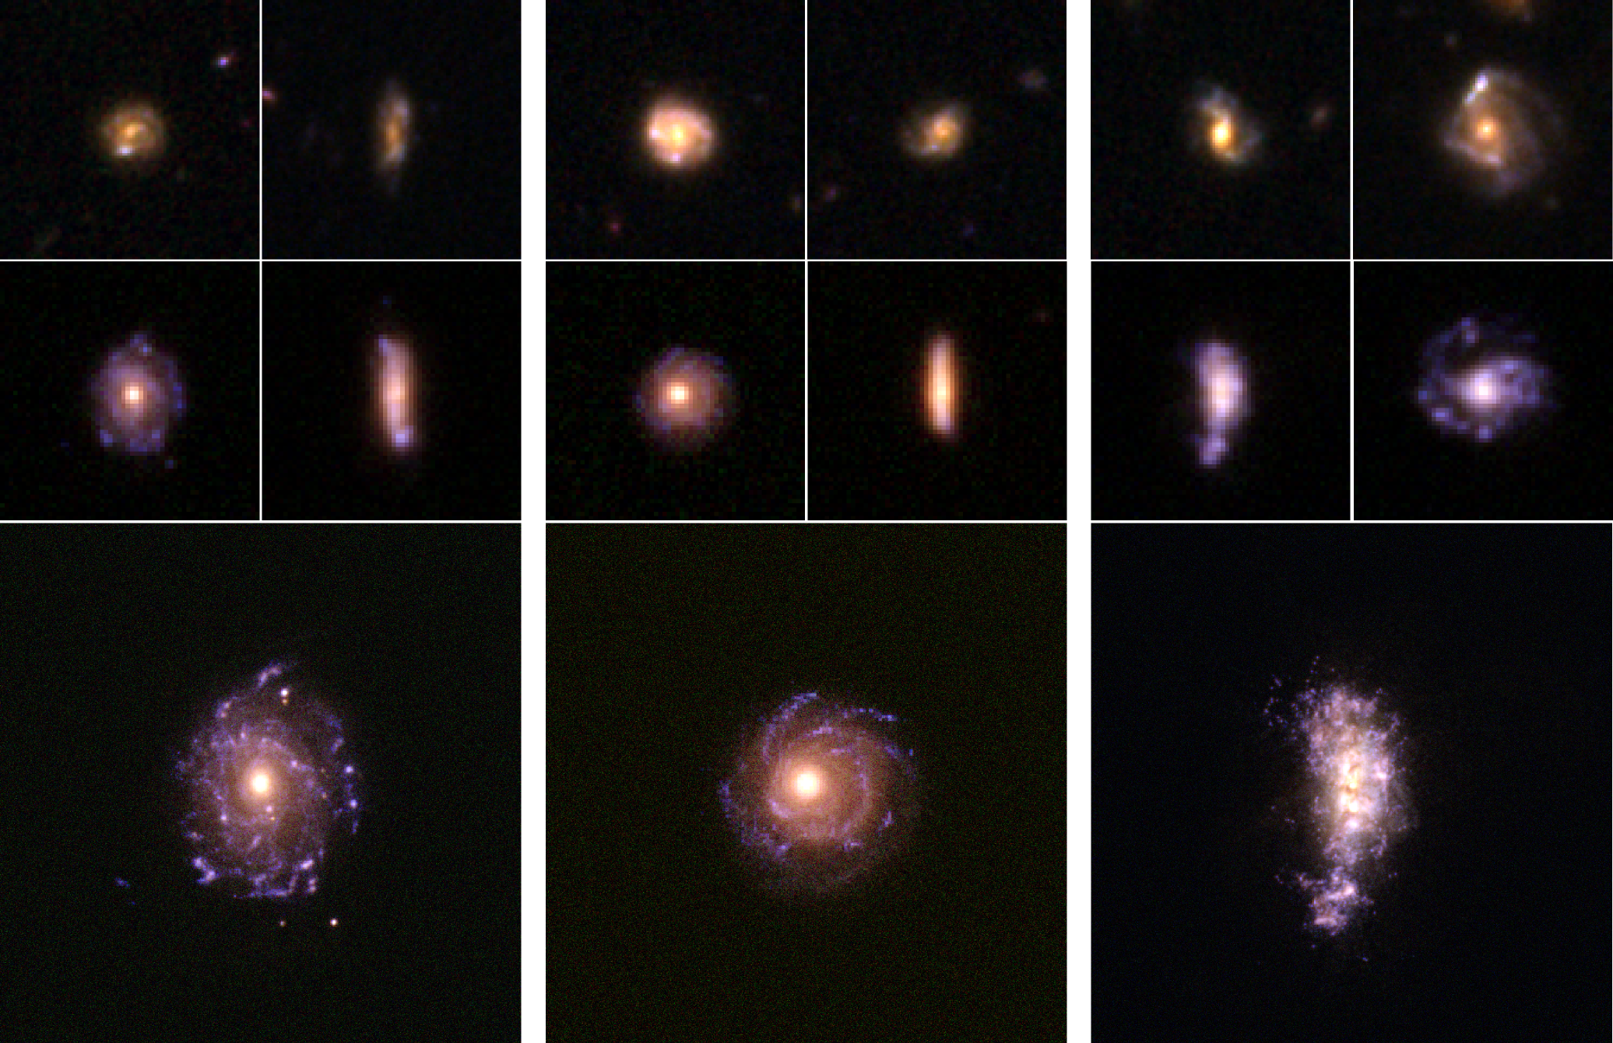
Theory component: “CANDELized” Hydrodyamical simulations
Real
Hydro simulations + Dust

Slide 54
CANDELS fields have also been “mocked” in geometry by 3 different
Semi-Analytic Models (SAMs)
Based on "Bolshoi" high-resolution cosmological N-body simulation and are carefully tuned to match the local galaxy stellar mass function construct
catalogs of mock galaxies on light cones that have the same geometry as the CANDELS survey, which should be particularly useful for quantifying the biases and uncertainties on measurements and inferences from the real observations.
Lu+15 (hint: use CANDELS in title to find article)

Slide 55
The relationship between the masses of halos found within N-Body Simulations and the stellar masses within their constituent galaxies can be estimated.

Slide 56
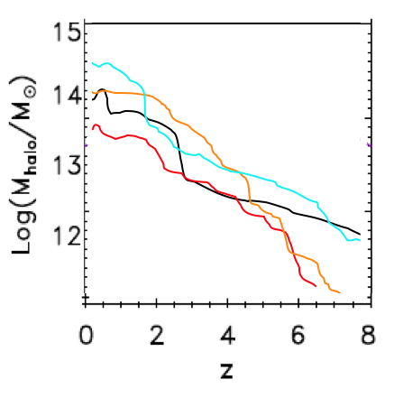
Dark halo mass growth vs. time: 4 examples
GALics dark-matter halos by Cattaneo et al. 2006
Dark Halo Mass
Redshift, z
Now Time BB

Slide 57

Dark halo mass growth vs. time: 4 examples
GALics dark-matter halos by Cattaneo et al. 2006
Clusters
Groups
Milky Way and M31 halos
Galaxies
Redshift, z

Slide 58

Dark halos of progressively smaller mass
15
14
13
12
Log (M_{halo}/M)
11
10
Cattaneo et al. 2006
9
0
2
4
6
8
Redshift, z

Slide 59
Key assumption: star-forming band in dark-halo mass
15
14
13
12
Log (M_{halo}/M)
11
Star-forming band
10
9
0
2
4
6
8
Redshift, z

Slide 60










A crude way to make the connection between galaxies and dark-matter halos*
Pick a slice of the universe in time (redshift)
Estimate the stellar mass of each galaxy in that slice (uses multiband photometry)
Rank order the galaxies from most to least massive (redshifts)
Rank order the dark-matter halos in a cosmological simulation of the same volume
Assign the most-massive galaxy to the most massive dark-matter halo, and so on down the list
Repeat for another slice of time (redshift)
* Called Stellar Halo Mass Abundance Matching (Behroozi+13, Moster+13)

Slide 61

Result: The galaxy’s mass in stars compared to the its mass in dark matter
Mass of the Milky Way
10%
Behroozi+ 13
1%
Fraction of the mass in the halo that is in the form of stars
Mass of the dark-matter halo (relative to the sun)
The conversion of gas into stars is inefficient for high-mass and low-mass dark-matter halos
Notes:
This figure shows the result of the “abundance matching” game described on slide #7. Dark matter halos are lined from low mass on the left to high mass on the right. (Even the smallest dark-matter halos considered here have a mass 10 billion times larger than the sun). The vertical axis shows the fraction of the mass in the halo that is the form of stars (as opposed to gas or dark matter).
The hypothesis from cosmology is that all of these dark-matter halos started with an almost perfectly uniform mix of gas and dark matter, with a universal fraction of about 17% of the total material being gas. This diagram shows that somehow galaxies have evolve so that the ratio of stellar mass to total mass today peaks at a value of 3% (rather than 17%) for galaxies about the mass of the Milky Way, and then drops to values less than 1% for galaxies that are a factor of 10 more massive or a factor of 10 less massive.
There are lots of ideas for why this might be the case, but there is as yet no clear consensus among experts on galaxy formation.

Slide 62

Some kind of feedback is needed to prevent all the gas from turning into stars
Feedback from black holes?
Feedback from supernovae?
The conversion of gas into stars is inefficient for high-mass and low-mass dark-matter halos

Slide 63


What did the Milky Way look like 11 billion years ago? (Papovich+15)

Slide 64

Andromeda-like progenitors

Slide 65

Halo Abundance Matching
Comparing galaxies at fixed number density roughly matches progenitors to their descendants
M31 progenitors
Milky Way
progenitors
Papovich+15

Slide 66

What did the Milky Way look like 11 billion years ago?
Papovich+15 (CANDELS + ZFOURGE)
Also Van Dokkum+ 13 3D-HST

Slide 67


Milky-Way & Andromeda progenitors
Papovich+15

Slide 68
This work Relies on High Precision Photometry Achieved with HST WFC3

Slide 69


A cosmologically significant population of star-bursting dwarf galaxies at z~1.7
Van der Wel+ 11

Slide 70

Bursting dwarfs at z ~ 1.7?
Ubiquitous, low-metallicity extreme starbursts among galaxies with low stellar-mass of Log M = 8.
Can produce most of stellar mass in today’s dwarf galaxies in only 4 billion years.
J-band excess likely due to [OIII] emission; EW up to 1000 A
van der Wel et al., 2011
Notes:
70

Slide 71




CANDELS is a Consensus Survey
Made in/of Heaven bringing together Strong Family Values
HST Director
HST TAC
Harry & Sandy
UDF
GDN
DEEP
EGS
COSMOS
WIDE
UDS
902 Orbits
GDS

Slide 72
CANDELS is a Consensus Survey
Made in/of Heaven bringing together Strong Family Values
Has traditional “Father” (Ferguson) & “Mother” (Faber)
Had a Marriage (though somewhat “shot-gun”, i.e. forced by the HST Director and TAC, rather than courtship & love)
Includes a Wedding Cake (3 equal layers of exposure time inversely scaled by area of sky)
Largest ever Wedding Gift (of over 900 HST orbits)
Gave birth to 5 bouncing Babies/fields

Slide 73


















SPACE
and RAINBOW Coalition of Diversity and Inclusiveness:
SPACE
THEORY
GROUND
MODES
Red-
Shifts
Stellar
Mass
Star & Dust
Formation
Structure Morphology
AGNs
QSOs
Winds & Feedback
Motions
Metallicity

Slide 74
and RAINBOW Coalition of Diversity and Inclusiveness as magnets for:
Deepest surveys from X-ray to radio, from ground to space
Best narrow to wide band, grism, spectral, IFU, etc. data
Mock catalogs from several different Semi-Analytic Models (SAMs) based on one cosmological N-body simulation
Most advanced CANDELized images and mock IFU data from the most advanced hydrodynamic simulations
Together, the rich suite of data within the CANDELS 5 fields enable diverse studies of the time/evolution of stellar mass, SFR, dust, AGNs, UV starbursts, dusty SF, metallicity, feedback, ages, etc.

Slide 75
While for CANDELS fields, the rich are getting richer,
the enormous & unsurpassed wealth of original & reduced data, cataloged & derived information, and customized models and simulations are being provided to the community, and will serve as the stepping stone and thus lasting legacy for deep surveys, especially measures of gas and dust that play a critical role in galaxy and AGN evolution, by JWST, ALMA, SKA, and other survey instruments for decades to come.

Slide 76
While for CANDELS fields, the rich are getting richer,
the enormous & unsurpassed wealth of original & reduced data, cataloged & derived information, and customized models and simulations are being provided to the community, and will serve as the stepping stone and thus lasting legacy for deep surveys, especially of gas and dust, by JWST, ALMA, SKA, and other survey instruments for decades to come.
TAKE-AWAY MESSAGE: the 5 CANDELS fields are where the action is and will be for evolutionary studies of distant field galaxies and AGNs for years to come.

Slide 77

Two Take-Away Messages
We remain far from understanding the origins, assembly, structure, motions, environments, etc. of gas, dust, stars, and SMBH in galaxies.
If you want to research the evolution of galaxies or AGN (outside of rich clusters), go to the CANDELS fields.
candels.ucolick.org
Notes:
For the young astronomers that can resist the lure of discovering new planets, there is plenty of space in observations or theory to make your mark in the study of the distant Universe. And the place to start would be the CANDELS fields.
And if you want to see bats, Austin is the place to be. But if you want to see redwoods and banana slugs or study distant galaxies, come to UC Santa Cruz.

Slide 78
Two Take-Away Messages
We remain far from understanding the origins, assembly, structure, motions, environments, etc. of gas, dust, stars, and SMBH in galaxies.
If you want to research the evolution of galaxies or AGN (outside of rich clusters), go to the CANDELS fields.
candels.ucolick.org
Notes:
For the young astronomers that can resist the lure of discovering new planets, there is plenty of space in observations or theory to make your mark in the study of the distant Universe. And the place to start would be the CANDELS fields.
And if you want to see bats, Austin is the place to be. But if you want to see redwoods and banana slugs or study distant galaxies, come to UC Santa Cruz.

Slide 79


Two Take-Away Messages
We remain far from understanding the origins, assembly, structure, motions, environments, etc. of gas, dust, stars, and SMBH in galaxies.
If you want to research the evolution of galaxies or AGN (outside of rich clusters), go to the CANDELS fields.
candels.ucolick.org
UC Santa Cruz
Notes:
For the young astronomers that can resist the lure of discovering new planets, there is plenty of space in observations or theory to make your mark in the study of the distant Universe. And the place to start would be the CANDELS fields.
And if you want to see bats, Austin is the place to be. But if you want to see redwoods and banana slugs or study distant galaxies, come to UC Santa Cruz, voted the most environmentally friendly and thus green campus in the country.

Slide 80
Look Afar, and
See the End from the Beginning
From Fortune Cookie eaten in 1986
Notes:
I must have been destined to be an observational cosmologist working on a project like CANDELS that looks so far back in time
… this was my fortune in a cookie I ate over 20 years ago

