Slide 1
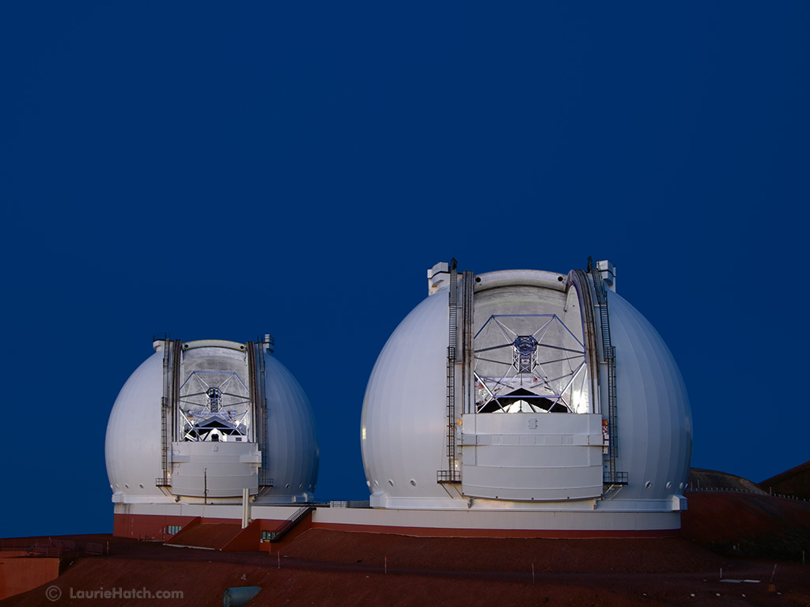
Highly Efficient Operations
Keck Scientific Strategic Planning 2009
Hilton Lewis
T. Armandroff, S. Adkins, R. Goodrich
J. Johnson, K. Kinoshita, R. Matsuda
September 18, 2009
Notes:
Primary Author:
Hilton Lewis
Contributing Authors:
Sean Adkins
Taft Armandroff
Robert Goodrich
James Johnson
Kyle Kinoshita
Richard Matsuda
Primary Source Documents:
The W. M. Keck Observatory Scientific Strategic Plan 2009
Modernizing the Control Systems of the Telescopes at the W. M. Keck Observatory – Proposal to the NSF ARI-R²

Slide 2
Rationale For Strategic Focus on
Highly Efficient Operations
To maximize the performance and observing efficiency of the sophisticated instrument suite and adaptive optics systems at the Observatory
To control and optimize operating and maintenance costs while continuing to support new capabilities
To continue to capitalize on our ~$250M+ investment by providing a powerful and flexible base for future enhancements

Slide 3
Strategic Initiatives to Improve Operational Efficiency
Initiatives currently planned or underway
  Telescope Control Systems Upgrade
  Continuing the MAGIQ upgrade program for acquisition/guiding/image quality monitoring systems
  Seismic upgrades
  Estimated cost ~$4M
Initiatives identified in Scientific Strategic Plan, but not yet funded in Observatory’s 5-Year Plan
  Optical Coatings
  Instrument Performance Monitoring

Slide 4
Telescope Control System Upgrade
Improve telescope pointing
Reduce acquisition time
Improve tracking performance
Reduce time lost to technical faults
Address obsolescence

Slide 5
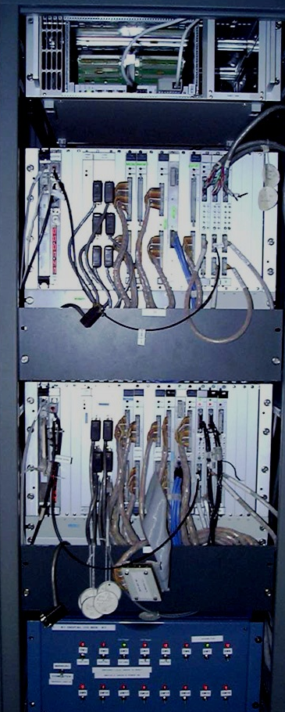
Address Obsolescence
Hardware replacement
  Addresses obsolescence, improve maintainability
    >50% obsolete (64% for critical axes control area)
    7 of 9 sub-systems at high risk
  Provides better decoupling of systems
  Covers VME electronics, computers, servo systems, controls
Software upgrade
  New framework to replace EPICS
  Consolidating 15 years of UIs
  Refactoring code base
  New pointing kernel
  Addressing interface reliability
  Knowledge transfer/refresh
Network performance upgrade

Slide 6
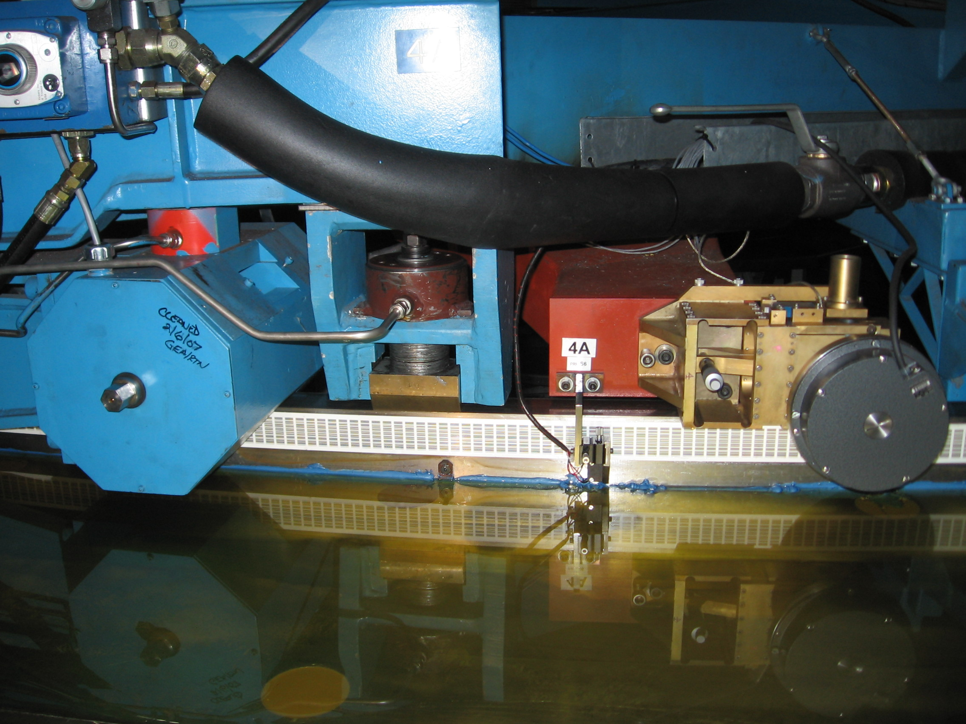
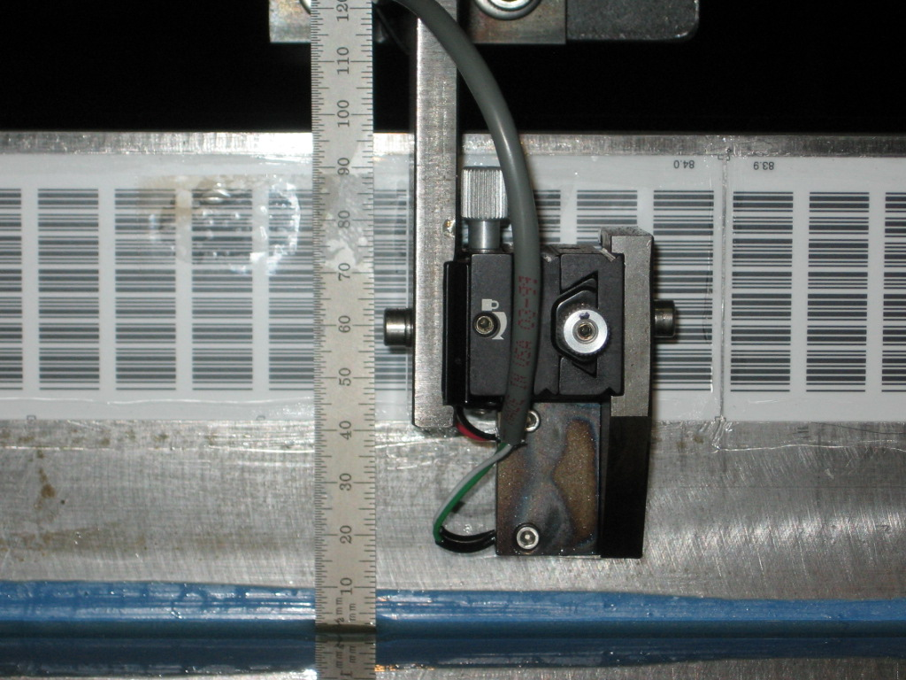
Improve Pointing and
Reduce Acquisition Time
Coarse acquisition accounts for 11% of clear time, lost to science observing
Poor (blind) pointing and offsetting performance is most common observer gripe
  Current pointing ~8" rms on K1, 5" rms on K2, with occasional much large errors
Upgrade telescope encoders to significantly improve pointing accuracy, reliability, recalibration
  GTC (similar design) has achieved ~2" without any real effort
  New goal is 1.5" rms achieved in practice
  Allows for much better pointing model
Increase slew speed at least to achieve current az spec of 1.3°/s. Goal is 2°/s
Notes:
From ARI proposal page 7: Metrics for the last 2 years show that the average lost time per night for slewing, coarse acquisition and fine acquisition is 4%, 7%, and 15% respectively, for a total of 26% lost time. These overheads can be considerably reduced.

Slide 7
Improve Tracking Performance
Current performance issues
  open loop (unguided) tracking is 50% worse than spec for short timescales (10 sec), and 20x worse than spec for long timescales (10 min)
    Significant limitation for offsetting, observing modes that don’t
    permit guiding (e.g. PCS)
  Poor tracking at high elevations (>85°) near meridian
Upgrade addresses these issues through better and more stable encoder performance, better pointing model and servo improvements
Will reduce acquisition times, improve performance overall
(even in guided case, especially with faint guide stars) and enable better performance for select observing modes
Notes:
Tracking performance:
short time scales (10 sec): 0.03” vs. spec of 0.02” rms
long time scales (10 min): 2.05” vs. spec of 0.1” rms
Better servo performance, feedforward control, better position angle computation

Slide 8
Reduce Time Lost To Technical Faults
Currently telescope control system technical faults account for 1.5% of clear time lost to observing
  In addition to lost time, faults are disruptive to programs, can jeopardize time sensitive observations
Redesigning hardware and software for fewer technical faults, reduced fault duration, faster recovery from faults
Addressing most important areas that result in lost time: communication with other subsystems, pointing problems, instrument selection

Slide 9
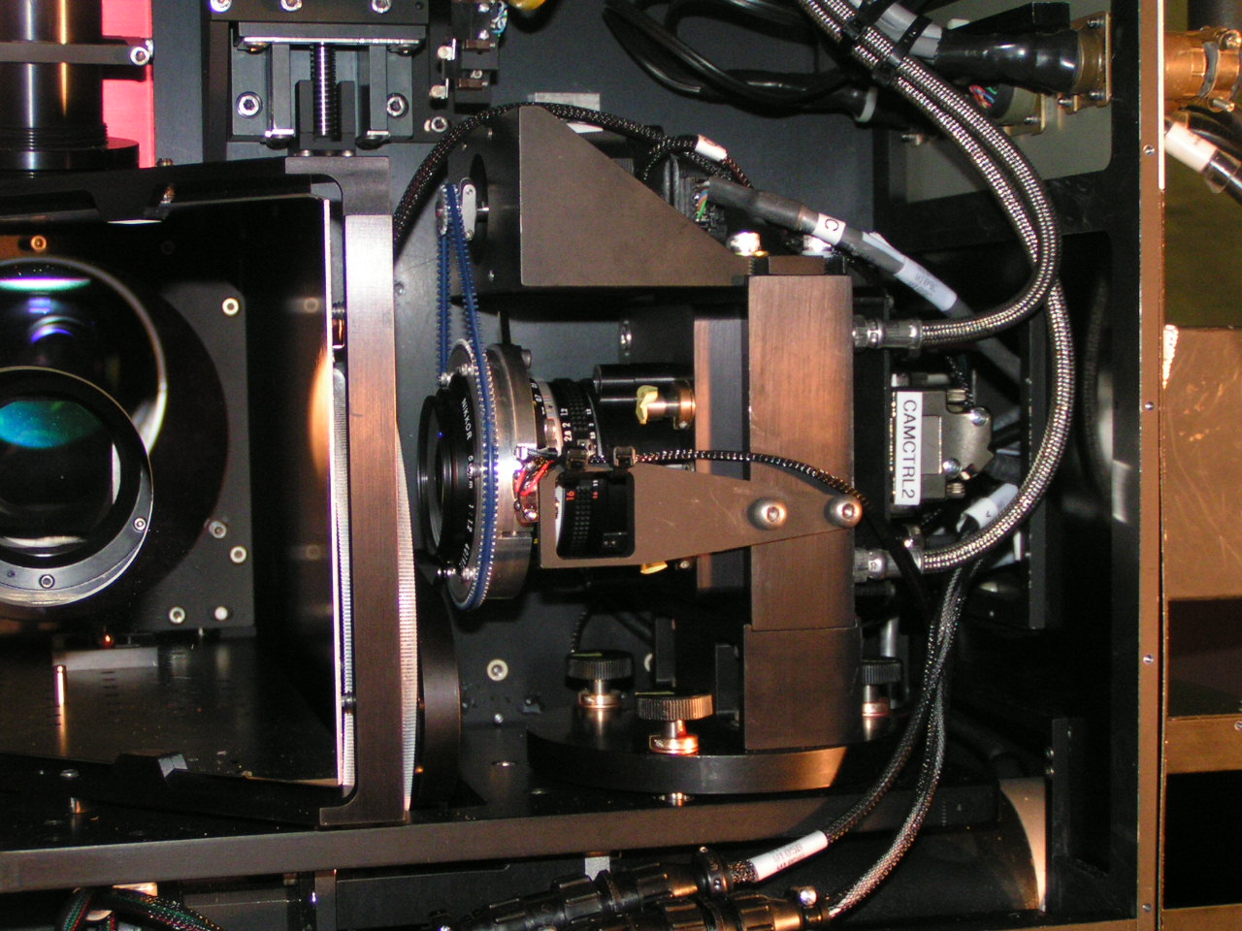
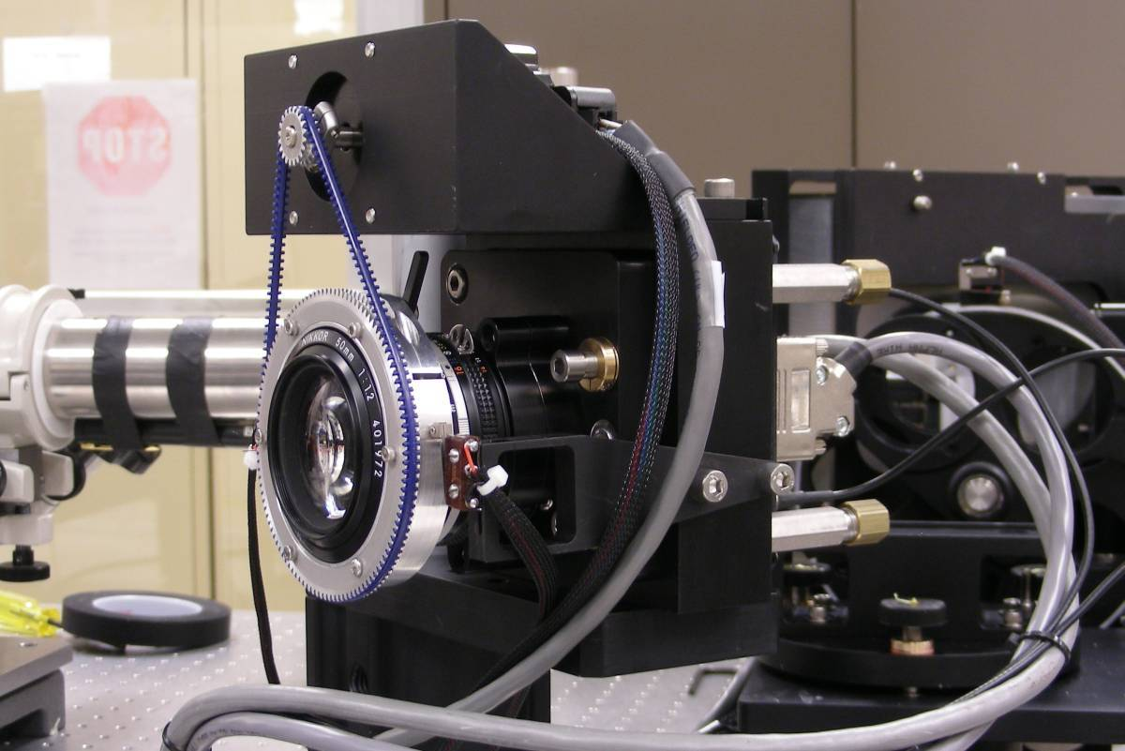
Acquisition/Guider Upgrades (MAGIQ)
Continues the MAGIQ upgrades
Addresses obsolescence of existing acquisition/guider systems
Larger field, better sensitivity, lower noise improves:
  fine acquisition performance
  more guide star candidates
  better guiding performance
Will provide real-time image quality monitoring and correction
Implementation order: HIRES, DEIMOS, SSC (2) and visitor ports
  Will start HIRES upgrade late in 2010

Slide 10
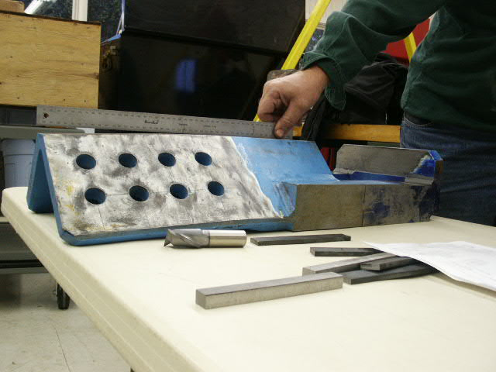
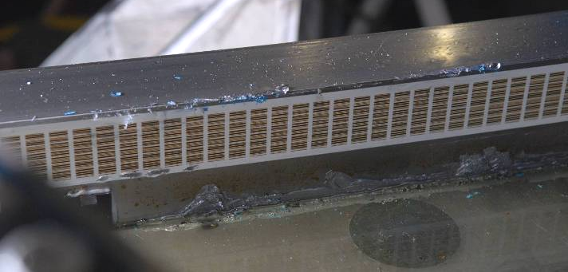
Enhance Seismic Protection
Large earthquakes possible in Hawaii (most recent was magnitude 6.8)
Telescopes designed for lower seismic loads than current zoning
Risk of significant damage, long recovery time (4 weeks to limited operation last time, full operation after 8 weeks, recovery cost ~$1M)
Plan to upgrade azimuth seismic restraint system for improved survivability, quicker recovery
Spin off improvements to az. axis stability (helps pointing), reliability (reduces faults) and maintainability (lowers operating cost)

Slide 11
Future Initiatives Recommended In Scientific Strategic Plan
Not Funded or Partially Funded
In 5-Year Plan

Slide 12
Advanced Optical Coatings
Longer term need to develop durable, broadband, high efficiency, coatings
Improved high efficiency coatings improve throughput
Durable coatings reduce the need to recoat primary segments, secondary, tertiary
  Reduces downtime, handling risk, staffing costs
Development synergies possible with other observatories, particularly the TMT
Possibility of shared coating facilities in Hawaii

Slide 13
Instrument Performance Monitoring
Goals
  Improve the understanding of extant data
  Provide metrics for QA, observer use
  Provide advance warning of instrument degradation
    Important for successful preventative maintenance program
  Assist in identification of modest upgrades that maximize bang-for-the-buck
Should be coupled with telescope performance monitoring, for greatest effectiveness
Funding for limited archival (KOA - HIRES, NIRSPEC) and instrument preventative maintenance program
  Only partial implementation of IPM goals funded

Slide 14
Conclusion
We are addressing the minimum upgrades needed to improve the observing efficiency and performance of the Observatory
  Many other opportunities for additional investment to take full advantage of our asset discussed in Scientific Strategic Plan
We seek to sustain the Observatory as one of the crown jewels of U.S. astronomy in the coming decade

