Slide 1
Science Case for Multi-object High Resolution Spectroscopy at Keck
R. Michael Rich (UCLA)
Judy Cohen (Caltech)

Slide 2
Project History
Fall 2007 RMR approaches UCO with plan to implement a multi-object echelle mode on DEIMOS (like MOE on Magellan)
April 2008 Rich & Cohen respond to Keck Call for proposals
June 2008 modest funding proposal to do concept study
Sep 2008 Epps dual VPH design proposed
Feb 2009 Keck multi-echelle included in Keck decadal report “RFI”

Slide 3
Current Status
Dual VPH at R~18,500 would deliver a multi-object high resolution spectrograph covering full LRIS FOV
Requires 0.35” slit
Coverage only 320A per VPH pair
Major modifications to LRIS
Major handling needed to change VPH pairs

Slide 4
Other options
Keck version of MOBIE (TMT echellette) would not be scalable from MOBIE
Fiber feed to HIRES overfills collimator; serious light loss due to vignetting
A totally new instrument ~15M
What about MOE on deimos? (Sutin & McWilliam 2003, SPIE, 4841, 1357

Slide 5
Deimos Echelle module (Epps quick look)
245 l/mm Newport grating (standard)
R~13,244, 0.5” slit
“custom” grating of 300 l/mm and 54.96º blaze at 5,000A in order 10 might work – but requires high setup angle of 77.46º ; 48% light loss due to vignetting.
Epps calculates R=19,334 with 1.09” slit
Some compromise might reduce vignetting while retaining resolution.
DEIMOS has larger FOV and would permit more multiplex

Slide 6
Science Case
Core case: Structure of dark matter on small scales
Composition of ultra-metal poor dwarf galaxies
Chemical complexity within dwarf galaxies
Composition of extragalactic globular clusters (Bernstein & McWilliam 08)
Abundance scale of Galactic bulge

Slide 7
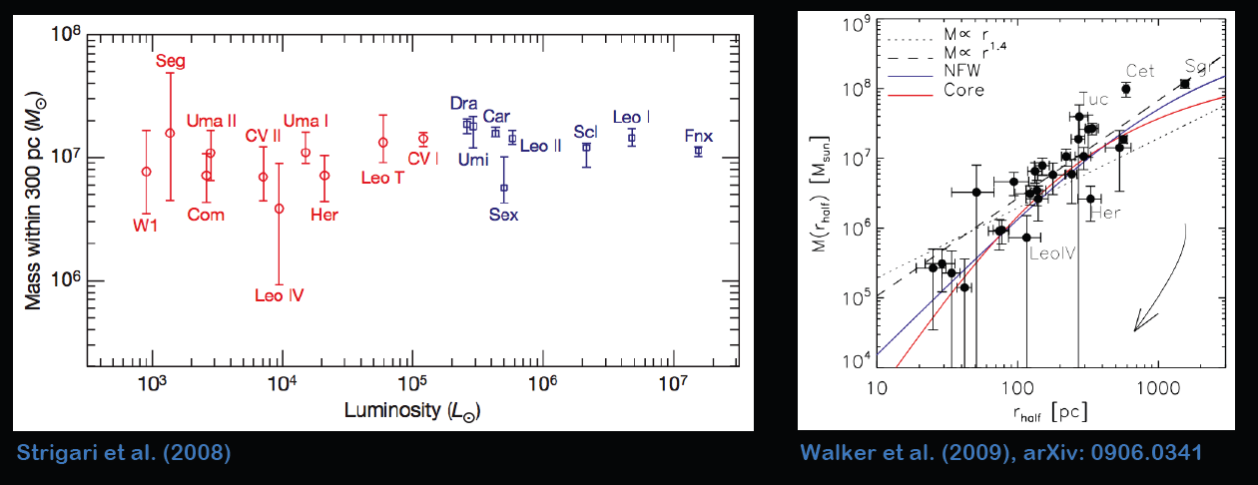
Dark Matter on Small Scales
Mass within certain radius is well defined for faint dSphs and ultra faints
Constaint within 300 pc (Strigari et al. 2008)
M(r_{h}) correlates with r_{h}
Courtesy A. Koch

Slide 8
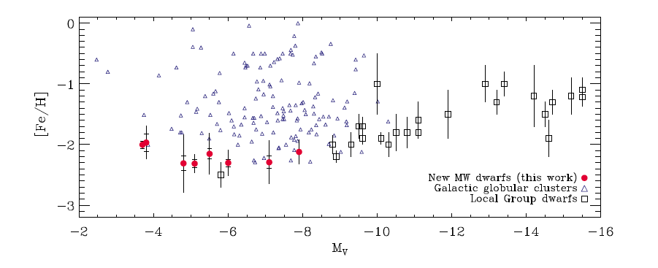
Metallicity-Luminosity relation?
Simon & Geha 2007; Kirby et al. 2008
Membership is critical to velocity dispersion, metallicity etc. – need high velocity precision.

Slide 9
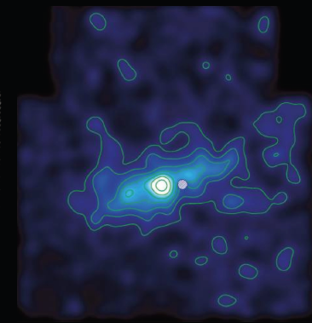
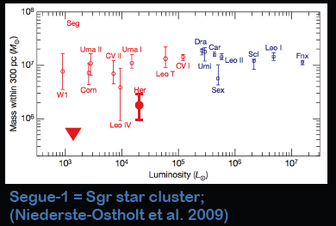
Use of Stromgren Phot to select members of Hercules
σ=5.1 ± 0.9 km/s (Simon & Geha 2007)
σ=3.7 ± 0.9 km/s (Aden et al. 2009) 21 members
Main issue: lower velocity dispersions push the envelope on precise measurements with the 1200 l/mm grating

Slide 10
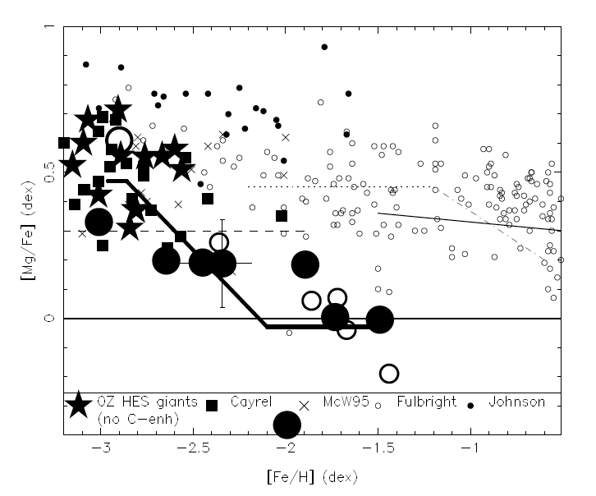
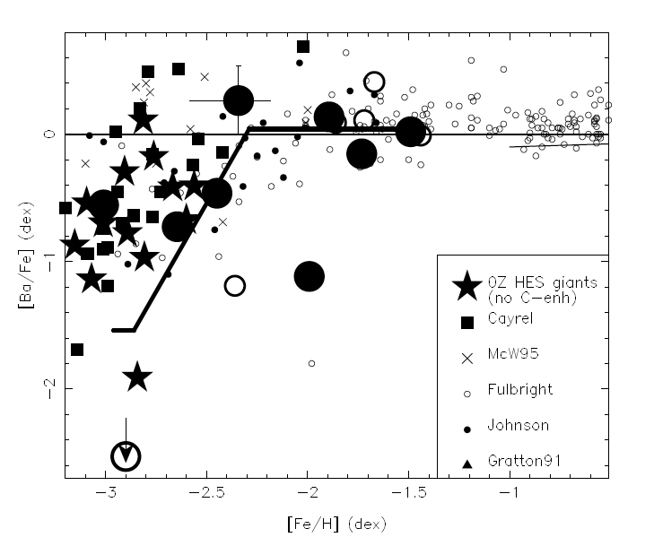
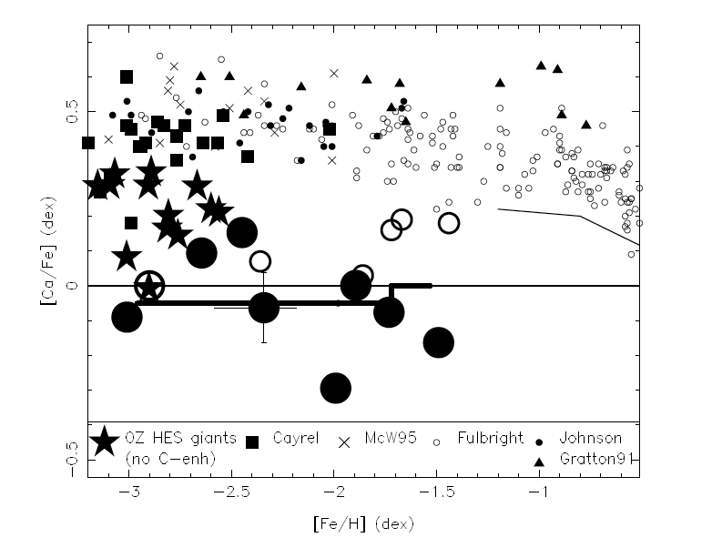
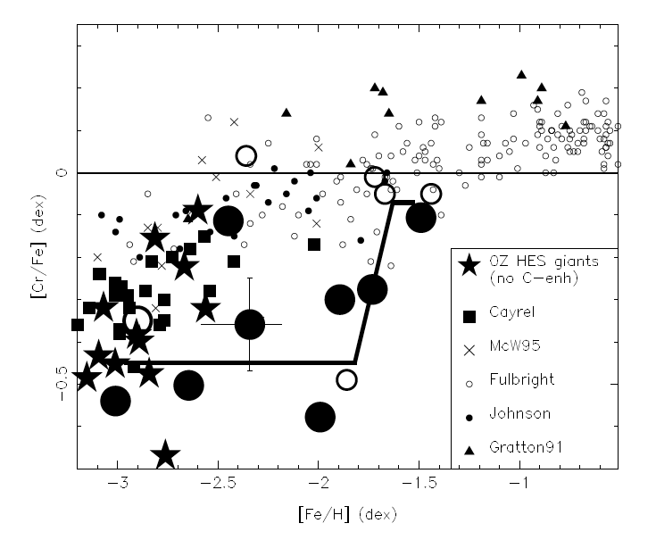
Complexity in Draco – Cohen & Huang 2009 - REQUIRES TRADITIONAL ABUNDANCE ANALYSIS

Slide 11
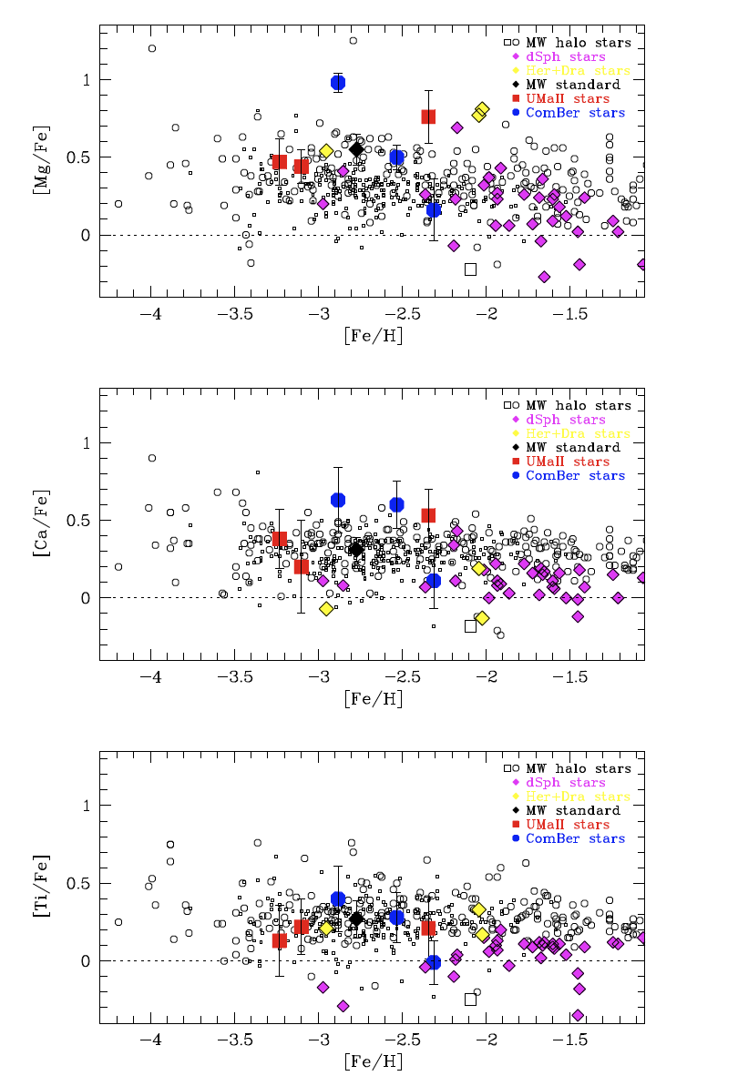
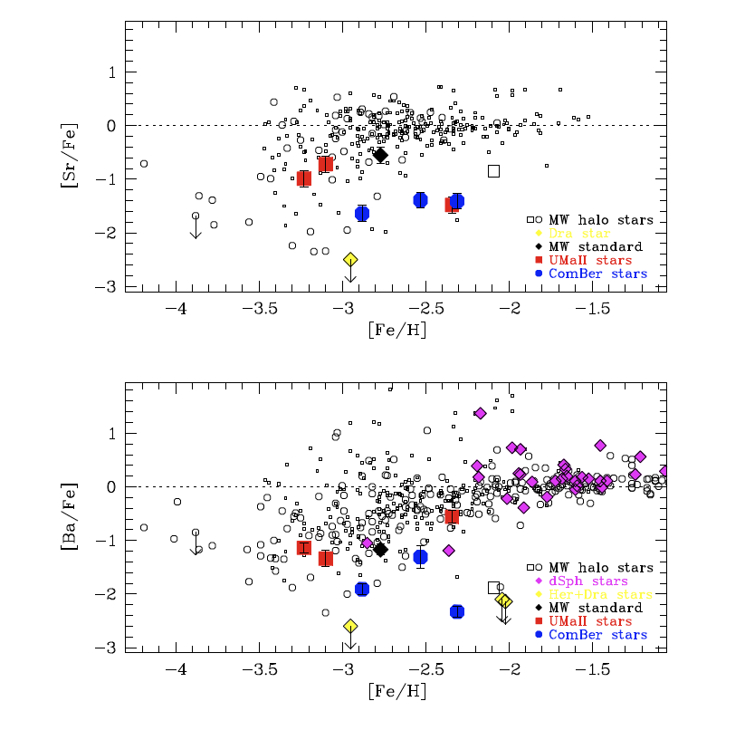
Frebel et al. 2009 Abundances in newly
low L dwarfs from single star HIRES

Slide 12
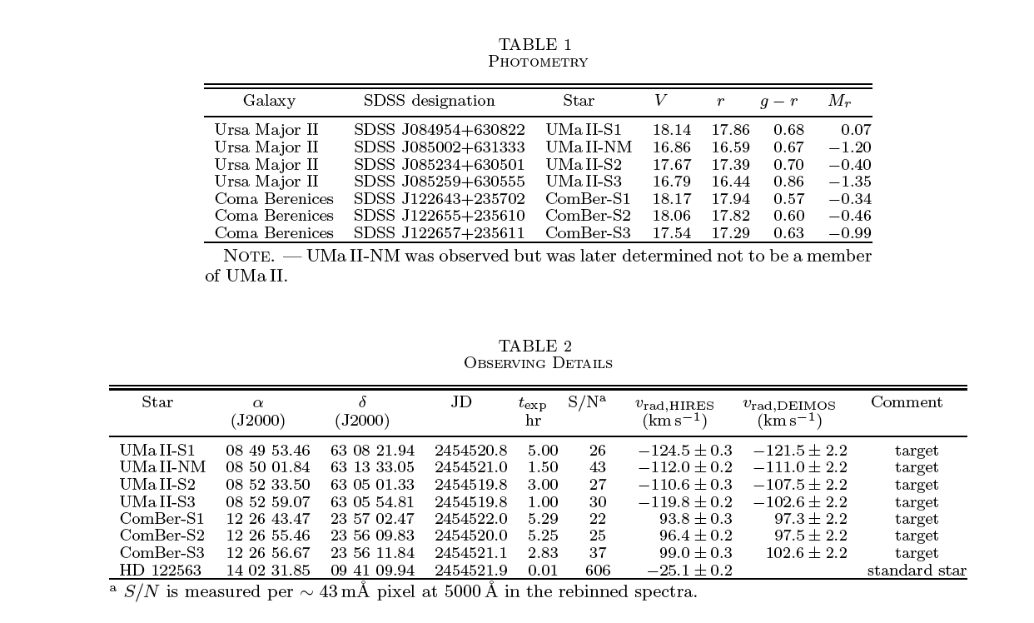
Frebel et al. ID 9 stars with r<18; their expos as long as 5.3hr per star

Slide 13
Bulge Abundance scale
Microlensed dwarfs more metal rich than giants
Cohen et al. 2009 proposes dwarf and giant abundance scale may disagree
Metal rich stars cannot be done via Kirby et al. method.
Keck/multi-hires could attack V=19 bulge dwarfs in situ

Slide 14
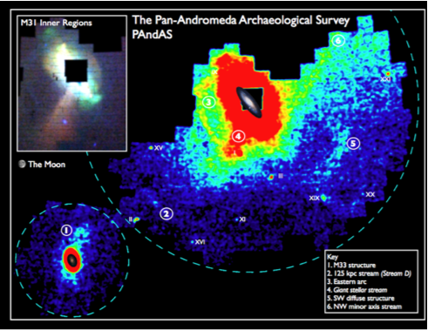
Many new systems around M31
Missing halo problem; “extended clusters” etc.
McConnachie et al. 2009 Nature

Slide 15
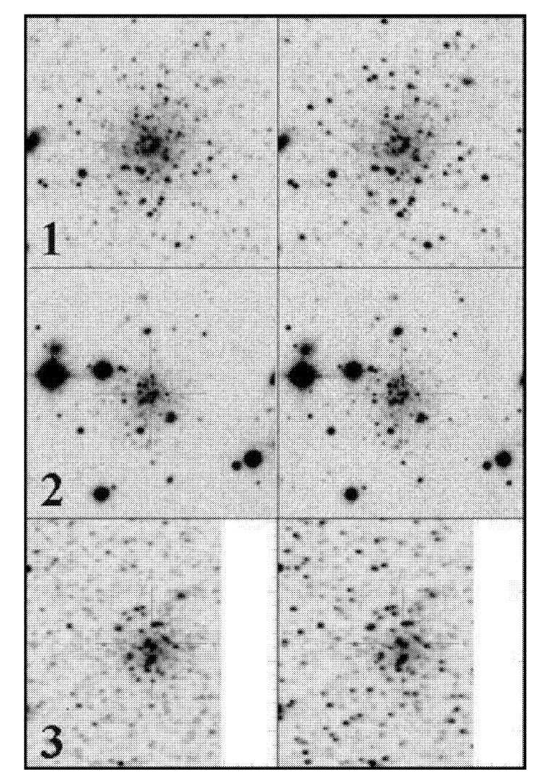
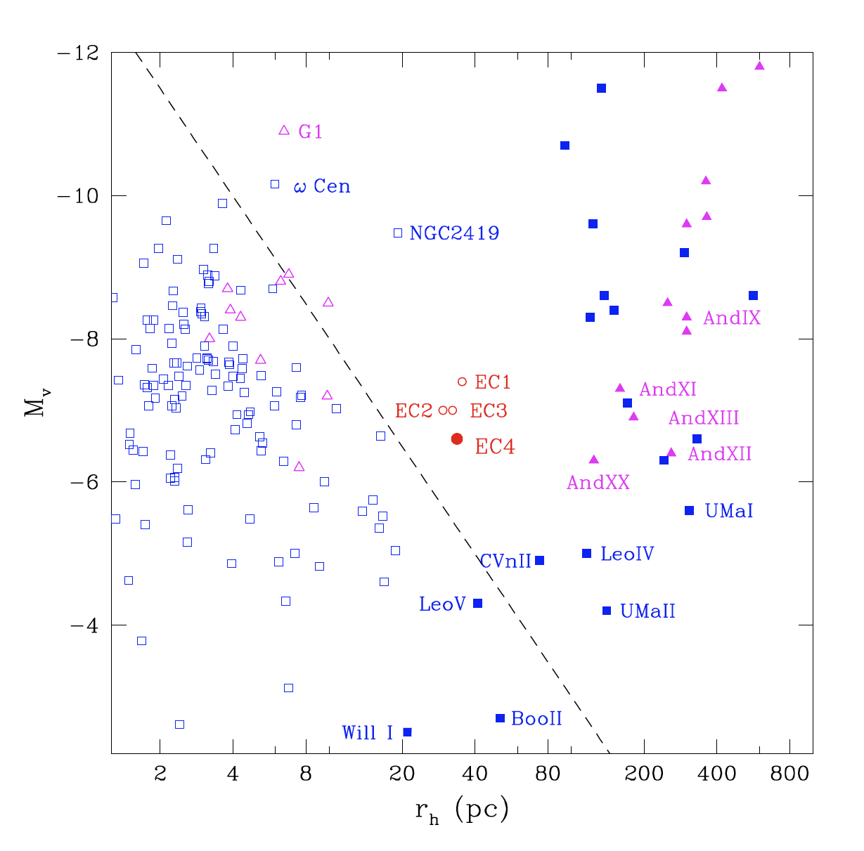
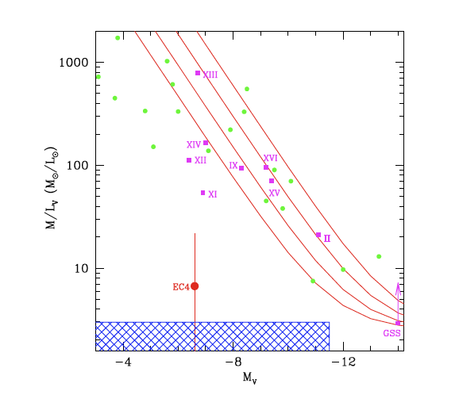
Extended clusters in M31
Huxor et al. 2005, 2008; Collins et al. 09
1’
σ=2.7 km/sec
Half-light radii tens of pc; between globulars & dSph
Globular
clusters
Collins et al. 2009

Slide 16
Future
PANSTARRS, LSST > new low L dwarfs
Conclusion of PandAS > new M31 dwarfs
Use of extragalactic GC systems for chemical evolution (Brodie, Bernstein, etc.)

Slide 17
Conclusion
Science case remains compelling
Explore both dual VPH and DEM options
Any new instrument should be highest possible throughput, continue Keck dominance for the faintest objects.
Entirely new instrument might also be of interest to Japan community; creative funding?

