Slide 1
Getting Started with
Python in Astronomy
Eric Gentry
1/22/2019
Astro 257

Slide 2
Target Audience
Someone who knows how to code, but hasn’t used python before.

Slide 3
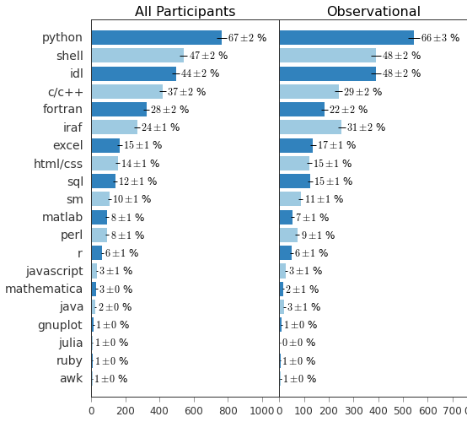
Why Python?
Free
Fast to write
  Your time is valuable
Large open source community
Most common language in astronomy

Slide 4
Which Python? 2 or 3?
3.
  If your advisor uses python 2-only code, fine, but I’d recommend having python 3 be your default, and only activating python 2 when needed.
    See: conda environments, pyenv, virtualenv or similar tools to switch versions
  Many major astronomy packages are no longer updated for python 2.
  If you use 2, you’re already missing out on the newest features.
The exact version of 3.X probably doesn’t matter.
  The current is 3.7, so that’s a good place to start.

Slide 5
Which installation?
python.org, anaconda, homebrew, macports, system?
Rules of thumb:
  Don’t use whatever python comes preinstalled on your computer. If you break it, your OS might stop working
  Don’t use homebrew/macports for your main python installation. It doesn’t know how to update python packages, so it might break things unknowingly
  In short, use anaconda or python.org
  (in my experience anaconda is easier to reinstall if you mess things up)

Slide 6
Which package manager?
To update python packages use either pip or conda, but don’t use both.
  If you installed using anaconda, use conda. If not, use pip.
pip install --upgrade <package_name>
conda install <package_name>
conda update <package_name>

Slide 7
Ways to Run Python
Interpreter (“REPL”)
  You manually type each line. All code lost when you exit
Script file (.py)
  The most reliable + easiest-to-reuse method
Jupyter notebook
  Most usefully-interactive.
  Great for testing out some code, and then when the code is mature, then you move the core code into a .py file

Slide 8
Ways to Run Python
Interpreter (“REPL”)
  You manually type each line. All code lost when you exit
Script file (.py)
  The most reliable + easiest-to-reuse method
Jupyter notebook
  Most usefully-interactive.
  Great for testing out some code, and then when the code is mature, then you move the core code into a .py file
[ Demo of each ]
Notes:
If people are using PCs, make sure to explain how they can run jupyter

Slide 9
[Interactive Demo]
Notebook can be downloaded here, or viewed here.

Slide 10
Best ways to learn a new language?
A project / class!
Blogs
  jakevdp.github.io (isn’t frequently updated, but has a great set of older posts)
  http://adwasser.space/tag/python.html
Tutorials
  http://www.astropy.org/astropy-tutorials/tutorials.html
Look at the code from a more experienced coder
Exercises
  practicepython.org

Slide 11
Communities / Mailing lists to learn more about Python in Astronomy
Facebook
  Python Users in Astronomy
  Astrostatistics (not python specific, but is partially python)
The “users” mailing lists for packages you often use
  E.g. astropy’s list
  Especially important if you regularly use a small/niche package
I’m sure there are plenty of other good options that I might not know of!

